Slide 1

Magnetic Resonance Imaging: how does it work?
Philippe Karan
Université de Sherbrooke
SCIL

Slide 2
Towards understanding MRI
Physics
  Magnetic field and induction
  Spin and precession
  Magnetization
  Resonance
Principles of magnetic resonance imaging
  Signal
  Relaxation
  Sequences
Image formation
  Slice selection
  Spatial encoding
Diffusion MRI
Magnetization transfer

Slide 3









Physics: magnetic field
Fundamental forces
gravitational
Fields
mathematical
representation
electromagnetic
strong
of interactions
weak
of the Universe
Notes:
A field is not made of anything in particular; it is just a region of space in which a force acts. The type of force determines what is influenced by the force in the field (e.g., in an electric field, the force will act on a charge).

Slide 4


Physics: magnetic field
Electromagnetic field
Electric field
Magnetic field
Spin
N
Electric charge
or
Varying magnetic field
Magnetic dipole
or
Varying electric field
Magnetic charge?
or
Varying electric field
S
Maxwell’s equations!
Induction

Slide 5

Physics: spin
Classical mecanics
Angular momentum: momentum from rotation
Quantum mecanics
Spin: intrinsic angular momentum
Quantized
particles
Property, like mass or charge
Electrons, protons, neutrons, have spin 1/2
Intrinsic magnetic dipole
N
When , only two eigenstates: "up" or "down"
S
B
Notes:
Particles with spin have an intrinsic magnetic moment proportionnal to their spin : mu = g q S / 2m.
Spin « one half »
The spins « tend » to align with B0

Slide 6
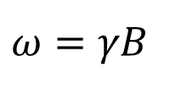
Physics: precession
Classical mecanics
Spins around its axis of rotation AND
around the direction of the gravitational field
g
Precession
Quantum mecanics
The magnetic moment precesses around
the external magnetic field
B
Precise angular frequency: Larmor frequency
$$ω=γB$$
Notes:
This precession is assuming a positive gyromagnetic ratio (as for protons or electrons)

Slide 7
Physics: spin and precession
But wait!
Which one is it?
We said: only two eigenstates: "up" or "down"
B
And now: the magnetic dipole precesses around the magnetic field
B
Notes:
This precession is assuming a positive gyromagnetic ratio (as for protons or electrons)

Slide 8

Physics: spin and precession
= a
+ b
Superposition of the two principal states
Precesses
When measured: only two states possible
For simplicity: we tend to talk about spins as either up or down,
but don’t forget about the superposition and precession!
Thanks quantum physics!
Notes:
This precession is assuming a positive gyromagnetic ratio (as for protons or electrons)

Slide 9
Physics: magnetization
What about an ensemble of spins?
M
M
B₀
B₀
B₀
No macroscopic
magnetic moment
Net magnetization
Net magnetization
increases with B
up: lower energy
down: higher energy
Notes:
The gap between energy levels increases with B and 1/T.
This is an exageration, as in reality, the amount of spins not cancelling out is about a few ppm. So the NMR signal is very weak.
We are gonna love magnetization for now on, because it will enable us to understand MRI without talking much about spins!

Slide 10
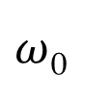
Physics: magnetization
Does the magnetization also precesses?
90° rotation
Static!
M_{z}
M_{z}
No
transverse magnetization
No
longitudinal
magnetization
M_{xy}
M_{xy}
B₀
$ω$₀
Precesses!
Not in phase
(not synchronized)
Spins contributing to M_{xy} : in phase coherence
(synchronized)
B₀

Slide 11



Physics: resonance
Remember induction?
M
Induced electric current
Varying magnetic field
Needs to move
Signal!
Exciting it the proper way
Resonant frequency
Maximum energy absorption
Push at the right beat
Notes:
Excite = give it energy
Analogie de la balançoire: pour la pousser plus haut
(donner de l’énergie), il faut pousser à la même fréquence
que le balan, sinon on brise l’élan. Même chose avec le spin,
pour l’exciter (lui donner de l’énergie), il faut le « pousser » à
sa fréquence « de résonance », qui est la fréquence de Larmor
dans ce cas-ci!
Ça prend de l’énergie pour être perpendiculaire au champ B0!

Slide 12

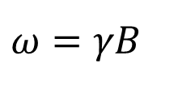
Physics: resonance
Remember induction?
M
Induced electric current
Varying magnetic field
Needs to move
Signal!
Exciting it the proper way
"Push" it at the
Larmor frequency
Resonant frequency
B
$$ω=γB$$
Notes:
Excite = give it energy
Analogie de la balançoire: pour la pousser plus haut
(donner de l’énergie), il faut pousser à la même fréquence
que le balan, sinon on brise l’élan. Même chose avec le spin,
pour l’exciter (lui donner de l’énergie), il faut le « pousser » à
sa fréquence « de résonance », qui est la fréquence de Larmor
dans ce cas-ci!
Ça prend de l’énergie pour être perpendiculaire au champ B0!

Slide 13
Towards understanding MRI
Physics
  Magnetic field and induction
  Spin and precession
  Magnetization
  Resonance
Principles of magnetic resonance imaging
  Signal
  Relaxation
  Sequences
Image formation
  Slice selection
  Spatial encoding
Diffusion MRI
Magnetization transfer

Slide 14

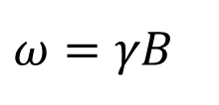
Principles of MRI: name
Nuclear
Magnetic Resonance Imaging
From the
nucleus
Spins and
magnetization
Resonance
phenomena
Making an
image
Hydrogen nucleus
Proton: spin 1/2
Excited at
Larmor frequency
M
O
Measured
via
induction
tons
H
H
B
$$ω=γB$$
Water
Notes:
Making an image from the nucleus’ spin / the nuclei’s magnetization, using the resonance phenomena.

Slide 15
Principles of MRI: sequences
Slice selection
G_{z}
What we know so far:
Phase encoding
G_{y}
Frequency encoding
G_{x}
RF pulses
Pre-pulse
90° RF pulse
180° RF pulse
Signal
Spin echo

Slide 16
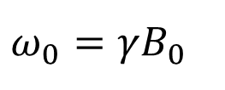
Principles of MRI: signal
z
M
Radio
frequency (RF)
pulse
B₀
Deflects out of equilibrium
Precesses around B₀
M
$$ω_{0}=γB_{0}$$
B₀
y
Larmor frequency
x
Notes:
Free induction decay

Slide 17


Principles of MRI: signal
z
z
z
z
B₀
B₀
B₀
B₀
M
M
$$θ$$
$$θ$$
M
$$θ$$
M
y
y
y
y
x
x
x
x
Precessing while tilting: spiral-like trajectory
Notes:
Free induction decay

Slide 18
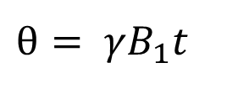
Principles of MRI: signal
z
z
B₀
B₀
RF pulse
$$θ$$
M
Rotating frame of reference
$$θ$$
M
y
y'
B₁
M precesses around B₁
RF pulse
=
Magnetic field B₁ applied for a short time
x
x'
$$θ= γB_{1}t$$
RF flip angle
Notes:
Free induction decay

Slide 19
Principles of MRI: signal
z
z
z
B₀
B₀
B₀
M_{z} = M
M
Longitudinal component
M_{z} = 0
M_{z}
M
$$θ$$
$$θ$$
M
M_{xy} = 0
y
y
y
M_{xy}
M_{xy} = M
Transverse component
x
x
x
Flip angle of 90°
=
maximum MR signal
Only M_{xy} is detected via induction
90° RF pulse
Notes:
Free induction decay

Slide 20
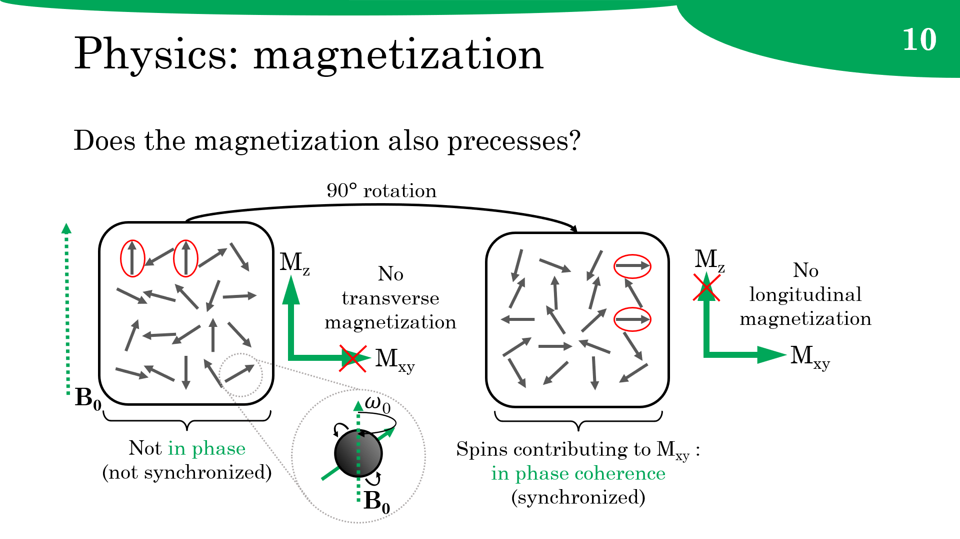
Principles of MRI: signal
What about individual spins?
RF pulse
coherent precession of the spins
RF pulse
Transverse magnetization M_{xy}
Random
precession
Coherent
precession
Notes:
After the RF pulse, the spins all precesse around B0 in a synchronized way, not cancelling each other out!

Slide 21
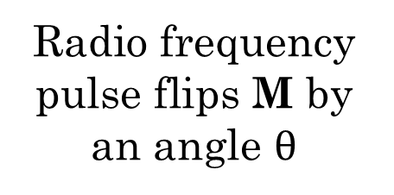
Principles of MRI: signal
Radio frequency
pulse flips M by an angle $θ$
Quick summary
z
z
B₀
Magnetization M starts precessing around B₀
B₀
M
$$θ$$
M
y
y
Rotating magnetic field induces a signal
Magnetic field B₀ generates a net magnetization M
x
x

Slide 22
Principles of MRI: sequences
Slice selection
G_{z}
What we know so far:
90° RF pulse flips the magnetization
Phase encoding
G_{y}
Frequency encoding
G_{x}
RF pulses
Pre-pulse
90° RF pulse
180° RF pulse
Signal
Spin echo

Slide 23
Principles of MRI: signal
Radio frequency
pulse flips M by an angle $θ$
Quick summary
z
z
B₀
Magnetization M starts precessing around B₀
B₀
M
$$θ$$
M
y
y
Rotating magnetic field induces a signal
Magnetic field B₀ generates a net magnetization M
x
x
How does this produce tissue contrast?

Slide 24
Principles of MRI: relaxation
Free Induction Decay
z
B₀
Signal amplitude
FID
$$θ$$
M
y
y
Time
Why is the signal diminishing?
x
x
The rate of relaxation depends of the tissue
Relaxation

Slide 25

Principles of MRI: relaxation
What is relaxation?
The process of M_{z} and M_{xy} returning to their equilibrium values
M
0
M_{z} is restored
M_{xy} disappears
M_{z}
M_{xy}
Different processes

Slide 26


Principles of MRI: relaxation
Longitudinal relaxation
M_{z} is restored
Spin-lattice relaxation
After RF pulse: excited nuclei
Higher energy
Spin up: nuclei at equilibrium
Lower energy
Excited nuclei
Transfer energy
Back to equilibrium
Interact with the lattice
External environment

Slide 27

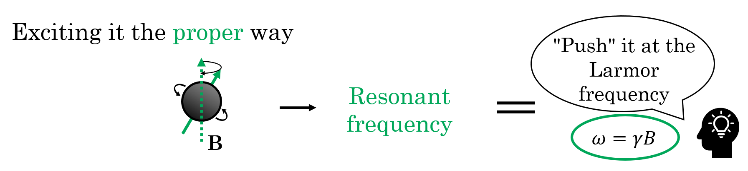
Principles of MRI: relaxation
Longitudinal relaxation
How is energy
transfered?
Lattice fields: magnetic fields created by surrounding nuclei
Must fluctuate at the Larmor frequency
Interacting
Also true for
relaxation!

Slide 28
Principles of MRI: relaxation
Longitudinal relaxation
Lattice fields: magnetic fields created by surrounding nuclei
Must fluctuate at the Larmor frequency
Fluctuations
of lattice fields
Molecular motion: rotation, vibration, translation
From random thermal activity
Size of molecules
Physical state
Macromolecules
Various frequency, or "speed"
Notes:
Don’t forget that these lattice fields are LOCAL, and thus, don’t affect all spins the same way, creating contrast!

Slide 29

Principles of MRI: relaxation
Longitudinal relaxation
Simplistic description
Size of molecules
Large
Medium
Small
Solids
Physical state
Solutions
Pure liquids
Low frequency
Larmor frequency
High frequency
Bound water
O
Macromolecules
Hydration layers
Structured water
O
H
H
Pathologies
Slows motion: faster relaxation
H
H
Macromolecule
Notes:
Don’t forget that these lattice fields are LOCAL, and thus, don’t affect all spins the same way, creating contrast!
Solids : high vibrational frequency
Pure liquids : high translational frequency

Slide 30
Principles of MRI: relaxation
Longitudinal relaxation
M_{z}
Initial M
Exponential fashion
T₁
Characteristic relaxation time T₁
63%
0
Time
Shorter T₁ = faster relaxation
Longer T₁ = slower relaxation
T₁ relaxation

Slide 31
Principles of MRI: relaxation
Longitudinal relaxation
Long T₁
Short T₁
Long T₁
Size of molecules
Large
Medium
Small
Solids
Physical state
Solutions
Pure liquids
Low frequency
Larmor frequency
High frequency
Bound water
O
Macromolecules
Hydration layers
Structured water
O
H
H
Longer T₁
Pathologies
Slows motion: faster relaxation
H
H
Macromolecule
Shorter T₁
Notes:
Don’t forget that these lattice fields are LOCAL, and thus, don’t affect all spins the same way, creating contrast!
Solids : high vibrational frequency
Pure liquids : high translational frequency

Slide 32
Principles of MRI: relaxation
Longitudinal relaxation
Lattice fields are local
T₁ values vary around the body
By measuring T₁, we can see different tissues!
Fat
Liver
Kidney
Lung
Gray matter
Cerebrospinal fluid
T₁
250 ms
White matter
Skeletal muscle
4000 ms

Slide 33
Principles of MRI: relaxation
Transverse relaxation
M_{xy} disappears
Spin-spin relaxation
Before RF pulse: random precession of the spins
M_{xy}
not in phase
After RF pulse: coherent precession of the spins
M_{xy}
in phase
T₁ relaxation
Spin-spin interaction
Coherent precession
Random precession
Notes:
Important to note that tipping the net magnetization (M) into the transverse plane does not cause all the spins to magically lock in phase. What happens is that those same spins initially showing some statistical "preference" for the z-direction prior to the RF-pulse have now been rotated into the transverse plane. The initial Boltzmann distribution "ordering" of spins in the z-direction has been preserved and transformed by the rotation into what can be considered "phase coherence" in the xy-plane. Simultaneously, the initial value of M in the z-direction (Mz) immediately before the RF-pulse has been converted to a net transverse magnetization (Mxy) after the pulse.
The presence of a non-zero net transverse magnetization (Mxy) is at any time is evidence of persistent asymmetry of transverse components of angular momentum, and what is commonly called "phase coherence." Any process that disrupts either the number or relative positions of these transverse components will result in T2 relaxation.

Slide 34
Principles of MRI: relaxation
Transverse relaxation
Gain of M_{z} Loss of M_{xy}
T₁ relaxation: spins transfering their excess energy
Any process causing longitudinal relaxation also results in transverse relaxation!
Spin-spin interaction: transverse relaxation without longitudinal relaxation

Slide 35
Principles of MRI: relaxation
Transverse relaxation
Feel a different magnetic field!
Interactions
between spins
Local magnetic
field variations
Individual nuclei start precessing at slightly different frequencies
Gradual and seemingly random dephasing
Decay of M_{xy}
z
z
z
z
y
y
y
y
M_{xy}
x
x
x
x
Time
Notes:
Interactions between spins, but also the presence of charges in mouvement, atoms with non-zero nuclear spins or atoms with superparamagnetic properties, cause the local magnetic fields to vary.

Slide 36
Principles of MRI: relaxation
z
z
z
z
y
y
y
y
M_{xy}
x
x
x
x
Time
M_{xy}
M after RF
Exponential fashion
T₂
Characteristic relaxation time T₂
T₂ relaxation
37%
0
Time

Slide 37
Principles of MRI: relaxation
Transverse relaxation
Solids and large molecules: fixed structure maintains the magnetic field
Short T₂
Pure liquids and small molecules: rapid translational motion averages the local magnetic field variations
Long T₂
Macromolecules and bound water: reduces the overall molecular motion
Shorter T₂
* T₂ time is independent of magnefield field strength

Slide 38
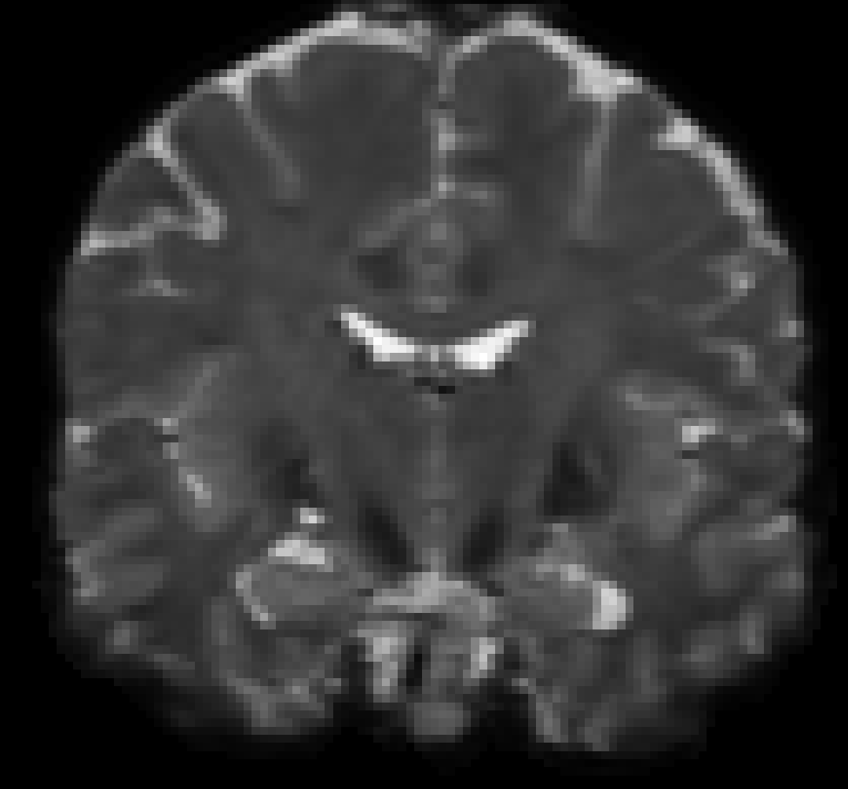
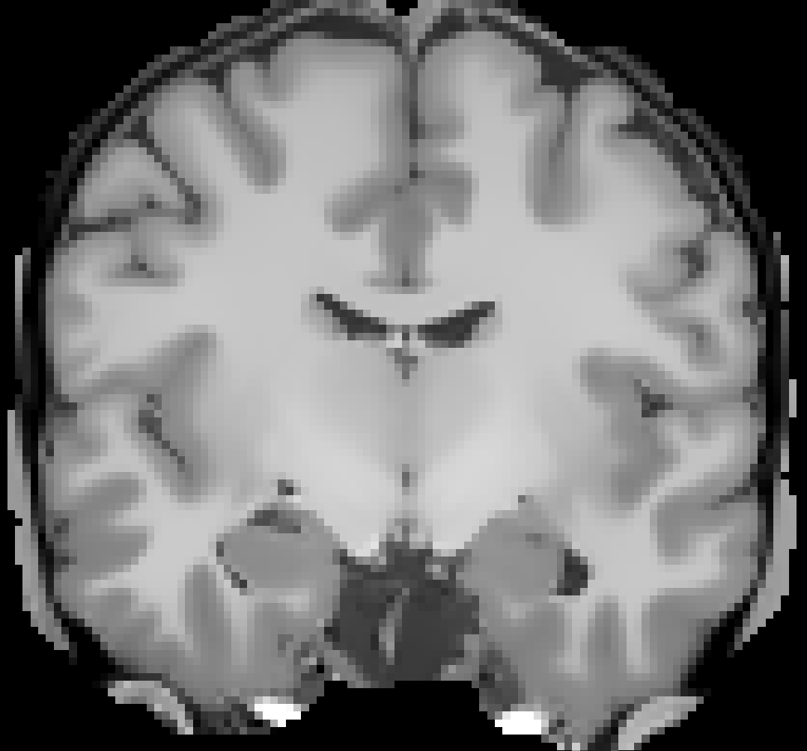
Principles of MRI: relaxation
Transverse relaxation
Local magnetic
field variations
T₂ values vary around the body
By measuring T₂, we can see different tissues!
Liver
Kidney
Lung
White matter
Cerebrospinal fluid
T₂
40 ms
Fat
Gray matter
2000 ms
Skeletal muscle
x10
Fat
Liver
Kidney
Lung
Gray matter
Cerebrospinal fluid
T₁
250 ms
White matter
Skeletal muscle
4000 ms

Slide 39
Principles of MRI: relaxation
M_{z}
Longitudinal relaxation
Initial M
T₁ relaxation
T₁
We can’t measure
directly
63%
0
Time
M_{xy}
Transverse relaxation
M after RF
T₂ relaxation
T₂
What we measure
directly
37%
***
0
Time

Slide 40
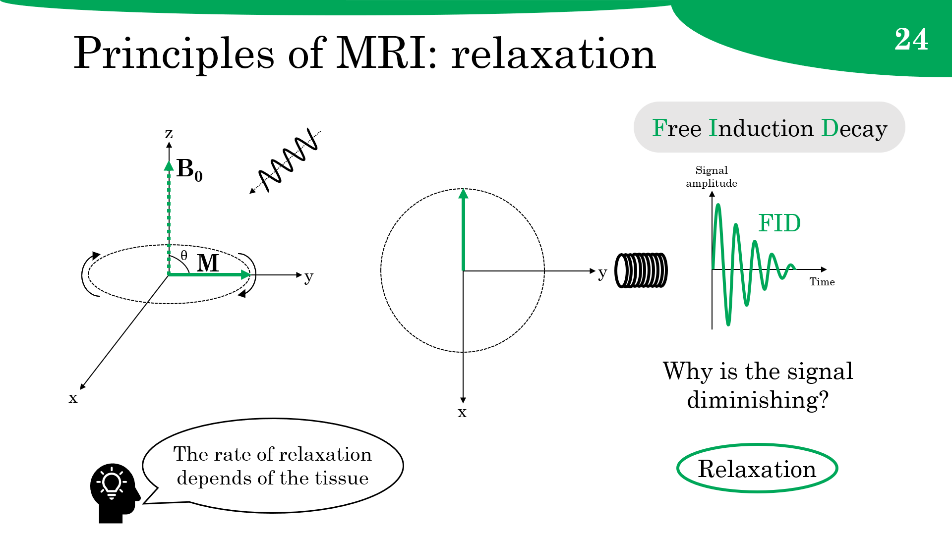
Principles of MRI: relaxation
*
T₂ relaxation

Slide 41
Principles of MRI: relaxation
Inhomogeneities in the applied magnetic field B₀
Reduce spin coherence
T₂ relaxation + field inhomogeneities = effective transverse relaxation
Signal amplitude
T₂*
T₂* decay
T₂ decay
Naive measurement:
T₂* relaxation
How do we measure
T₂ relaxation?
Time

Slide 42
Principles of MRI: spin echo
T₂ relaxation
Field inhomogeneities
fundamentally
different
random
static influence
irreversible
"reversible"
z
z
z
z
y
y
y
y
M_{xy}
x
x
x
x
Time

Slide 43


Principles of MRI: spin echo
Analogy: Runners on a circular track with wind
No static influence
Only random influence
Different abilities
of runners
Inhomogeneities in
the magnetic field
In phase
Dephasing
Turn around!
Random influence
of the wind
Random spin-spin
interactions

Slide 44
Principles of MRI: spin echo
Turn around!
After
90° pulse
Dephasing
180° RF
pulse
z
z
z
z
slowest
y
y
y
y
M_{xy}
x
x
x
x
fastest
After
180° pulse
Rephasing
Time
z
z
z
z
Spin echo
slowest
M_{xy}
y
y
y
y
fastest
x
x
x
x

Slide 45
Principles of MRI: spin echo
Echo signal amplitude smaller than original FID
Signal amplitude
T₂ decay
Spin-spin interactions
(wind) are not reversible
T₂* decay
Time
T₂ relaxation
1st echo
2nd echo
FID
TE: echo time
TE/2
TE
90° RF
pulse
180° RF
pulse
180° RF
pulse
Notes:
Measuring spin echo signal, instead of the FID, permits more complete evolution of spin-spin interactions while offering a vehicle for correcting the influence of static field inhomogeneities.

Slide 46
Principles of MRI: sequences
Slice selection
G_{z}
What we know so far:
90° RF pulse flips the magnetization
90 ° and 180° RF pulses create a spin echo
Phase encoding
G_{y}
Frequency encoding
G_{x}
RF pulses
Pre-pulse
90° RF pulse
180° RF pulse
Signal
Spin echo

Slide 47
Principles of MRI: inversion
What about measuring
T₁ relaxation?
M_{z}
M initial
Short T₁
Many tricks
Long T₁
0
Time
Inversion recovery
-M initial
Suppression of tissues
TI
180° RF pre-pulse
90° RF pulse

Slide 48
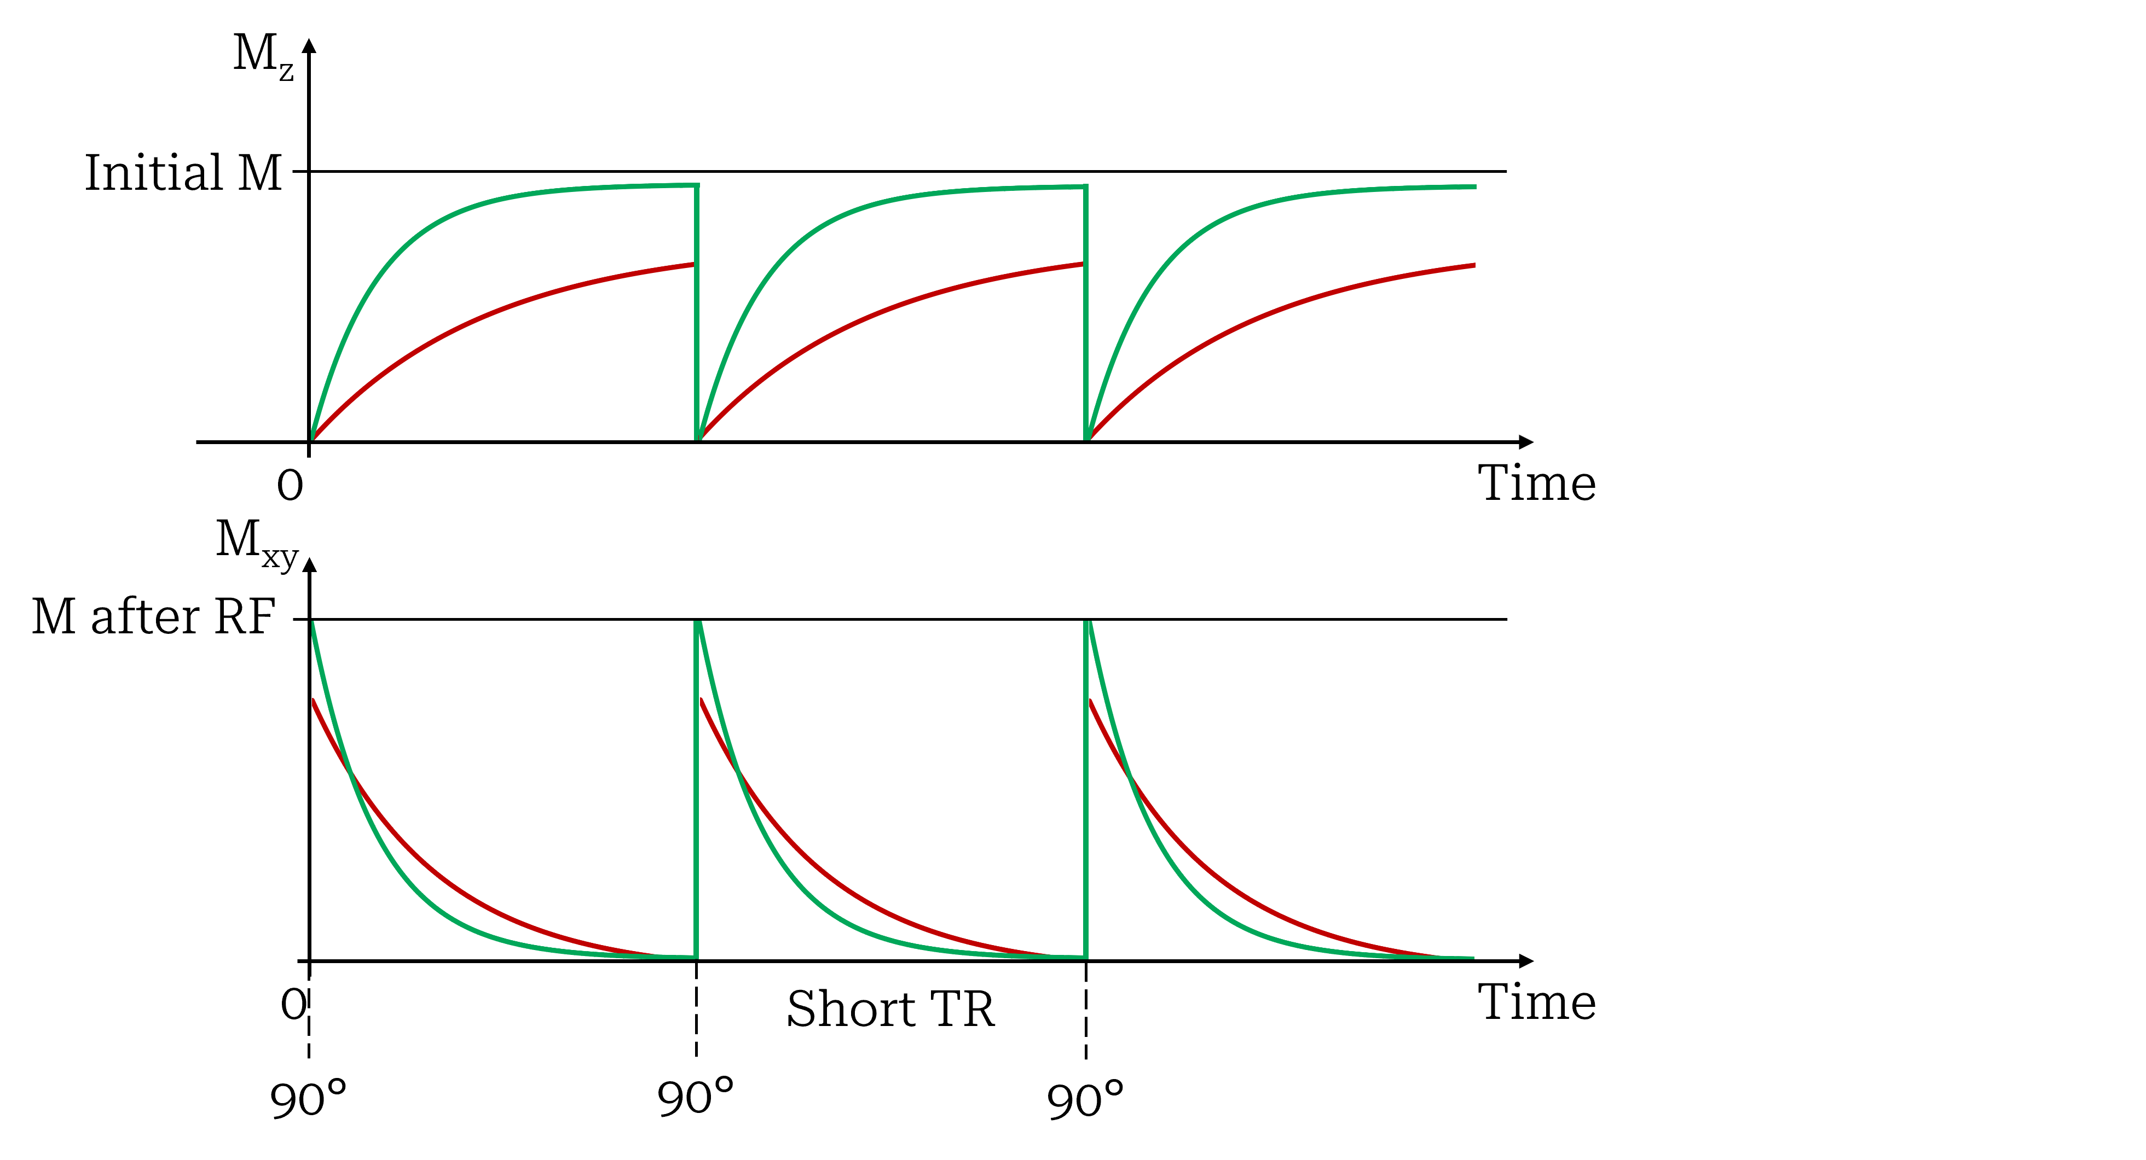
Principles of MRI: timing
T₁ and T₂ short
T₁ and T₂ long
Combination of short TE and short TR gives T₁ contrast.
As opposed to typical long TR and "long" TE giving T₂ contrast.
Short TE
RF pulses

Slide 49
Principles of MRI: sequences
Slice selection
G_{z}
What we know so far:
90° RF pulse flips the magnetization
90 ° and 180° RF pulses create a spin echo
Pre-pulse prepares the spins for contrast
Phase encoding
G_{y}
Frequency encoding
G_{x}
RF pulses
Pre-pulse
90° RF pulse
180° RF pulse
Signal
Spin echo

Slide 50
Towards understanding MRI
Physics
  Magnetic field and induction
  Spin and precession
  Magnetization
  Resonance
Principles of magnetic resonance imaging
  Signal
  Relaxation
  Sequences
Image formation
  Slice selection
  Spatial encoding
Diffusion MRI
Magnetization transfer

Slide 51
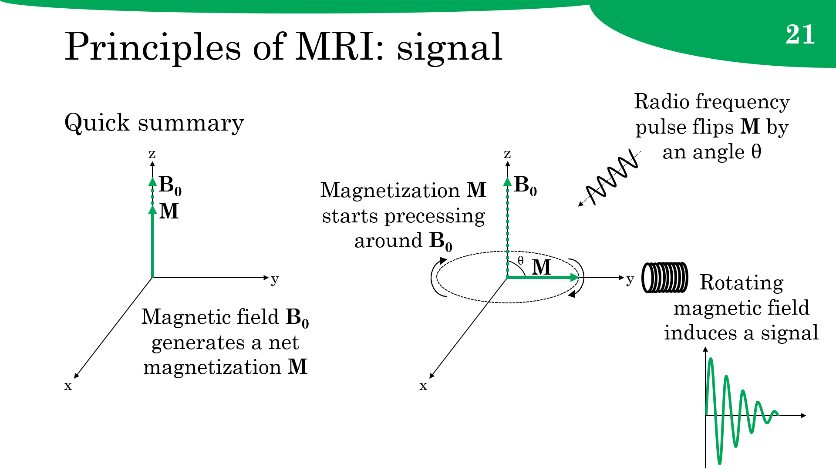
Image formation
Larmor frequency
2.
Whole head
resonates at the same frequency*
3.
4.
1.
No spatial information!

Slide 52
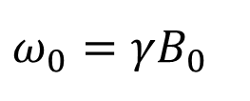
Image formation
Solution: encode the spatial position of the nuclei into the signal
Selection of an image slice
Spatial encoding of the signal coming from that slice
Larmor frequency
Function of the strength of B₀
$$ω_{0}=γB_{0}$$
Make it a function of position
Magnetic field gradient

Slide 53

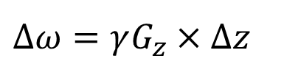
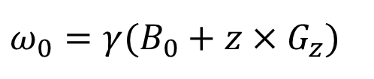
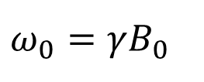
Image formation: slices
G_{z}
B₀
z
Gradient amplitude
One single
Larmor frequency
Multiple
Larmor frequencies
Slice thickness
$$ω_{0}=γ(B_{0}+z×G_{z})$$
$$ω_{0}=γB_{0}$$
RF frequency
Bandwidth
RF pulse
Bandwidth
Slice thickness
Magnetic field gradient
$$∆ω=γG_{z}×∆z$$
Gradient amplitude

Slide 54
Image formation: slices
G_{z}
B₀
z
Spin phase
G_{z}
B₀
z
Spin phase
Dephasing:
Spiral staircase
Maximum
signal
RF frequency
RF frequency
Slice selection gradient
Spin rephasing gradient

Slide 55
Principles of MRI: sequences
Slice selection
G_{z}
What we know so far:
90° RF pulse flips the magnetization
90 ° and 180° RF pulses create a spin echo
Pre-pulse prepares the spins for contrast
Gradients G_{z} select a single slice
Phase encoding
G_{y}
Frequency encoding
G_{x}
RF pulses
Pre-pulse
90° RF pulse
180° RF pulse
Signal
Spin echo

Slide 56

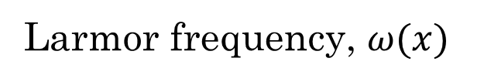
Image formation: encodings
Larmor frequency, $ω(x)$
No dephasing
Dephasing along G_{x}
y
z
x
G_{x}
Notes:
Tout au long de l’application du gradient G_x, le niveau de déphasage augmente (de façon périodique, en passant parfois par des rephasages). Donc durant G_x on parcourt la ligne k_x.

Slide 57





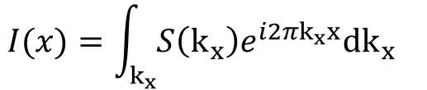


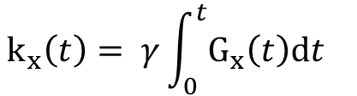
Image formation: encodings
No gradient
No dephasing
x
G_{x}
$φ(x,t)$
k_{x}
$$e^{i2πφ}$$
or
Dephasing
x
G_{x}
0°
360°
Phase
G_{x}
$$φ\left(x,t\right)=k_{x}(t)∙x$$
$φ(x,t)$
k_{x}
$$e^{i2πφ}$$
x
G_{x}
Amount of dephasing
0°
360°
720°
$$k_{x}\left(t\right)= γ\int_{0}^{t}{G_{x}\left(t\right)dt}$$
$φ(x,t)$
k_{x}
Spatial frequency
$$e^{i2πφ}$$
x
G_{x}
Inverse Fourier Transform
0°
360°
720°
1080°
$$I(x)=\int_{k_{x}}{S\left(k_{x}\right)e^{i2πk_{x}x}dk_{x}}$$
MRI signal
Notes:
Tout au long de l’application du gradient G_x, le niveau de déphasage augmente (de façon périodique, en passant parfois par des rephasages). Donc durant G_x on parcourt la ligne k_x.

Slide 58
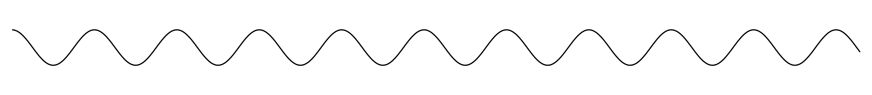
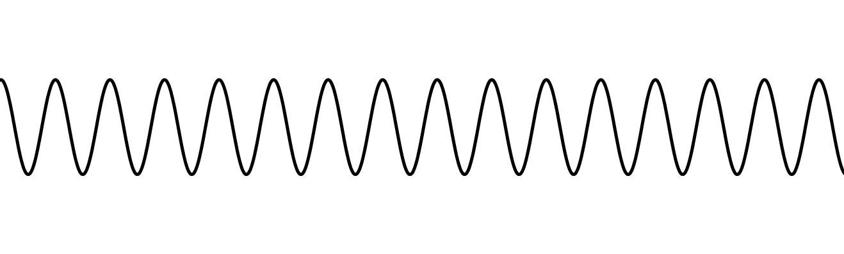
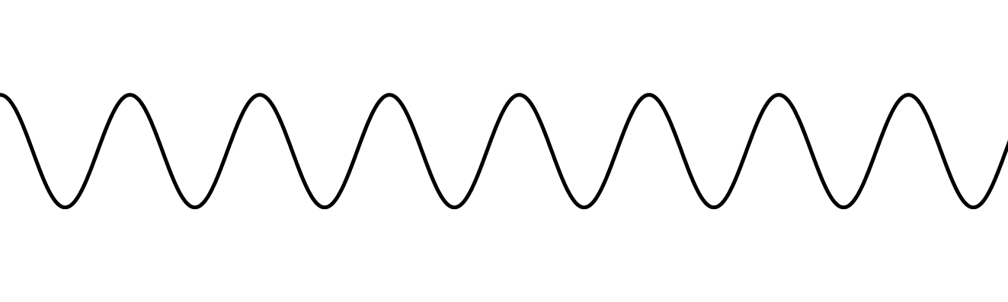















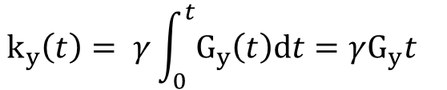












Image formation: encodings
Spatial encoding with the phase encoding gradient G_{y}.
G_{y}
Phase memory!
$ω$₀
$ω$₀
$ω$₀
$ω$₊₊
$ω$₊₊
$ω$₊₊
$ω$₀
$ω$₀
$ω$₀
++
Same
frequency
$ω$₀
$ω$₀
$ω$₀
$ω$₊
$ω$₊
$ω$₊
$ω$₀
$ω$₀
$ω$₀
+
Different
phases
y
$ω$₀
$ω$₀
$ω$₀
$ω$₀
$ω$₀
$ω$₀
$ω$₀
$ω$₀
$ω$₀
0
z
x
Time
Single gradient
$$k_{y}\left(t\right)= γ\int_{0}^{t}{G_{y}\left(t\right)dt}=γG_{y}t$$
Single value of k_{y}:
G_{y}
$$t$$
Notes:
Tout au long de l’application du gradient G_x, le niveau de déphasage augmente (de façon périodique, en passant parfois par des rephasages). Donc durant G_x on parcourt la ligne k_x.

Slide 59



























Image formation: encodings
Spatial encoding with the frequency encoding gradient G_{x}.
$ω$₀
$ω$₀
$ω$₀
$ω$₀
$ω$₊
$ω$₊₊
$ω$₀
$ω$₊
$ω$₀
$ω$₊₊
$ω$₊₊
$ω$₊
$ω$₀
$ω$₀
$ω$₀
$ω$₀
$ω$₊
$ω$₊₊
$ω$₀
$ω$₊
$ω$₀
$ω$₊
$ω$₊₊
$ω$₊₊
$ω$₀
$ω$₀
$ω$₀
$ω$₀
$ω$₊
$ω$₊₊
$ω$₀
$ω$₊
$ω$₊₊
$ω$₀
$ω$₊
y
$ω$₊₊
G_{x}
G_{x}
G_{x}
x
0
+
++
0
+
++
0
+
++
z
Time
k_{x}=0, k_{y}
k_{x}= $γ$G_{x}t₁, k_{y}
k_{x}= $γ$G_{x}t₂, k_{y}
k_{x}= $γ$G_{x}t₃, k_{y}
G_{y}
G_{x}
G_{x}
G_{x}
$t$₁
$t$₂
$t$₃
Notes:
Tout au long de l’application du gradient G_x, le niveau de déphasage augmente (de façon périodique, en passant parfois par des rephasages). Donc durant G_x on parcourt la ligne k_x.

Slide 60
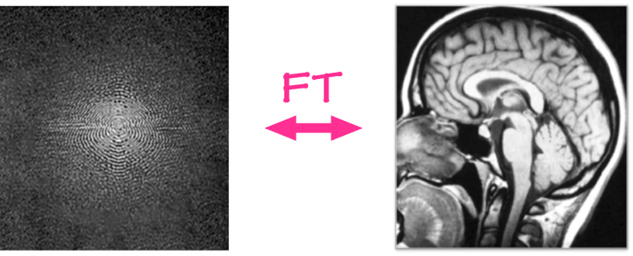


Image formation: encodings
Spatial encoding of the signal from a slice, in both axis.
N_{y} gradients
N_{x} points
Phase encoding
Frequency encoding
G_{y}
G_{x}
S(k_{x}, k_{y})
k_{y}
k_{x}
Measurement
One gradient G_{x},
N_{x} data points
Points in
k-space
Image
k_{y}
N_{y} gradients G_{y}
Inverse
2D FT
N_{y} lines
…
…
$$M(x, y) =\int_{k_{x}}{\int_{k_{y}}{S\left(k_{x}, k_{y}\right)}e^{i2π(k_{x}x+k_{y}y)}dk_{y}dk_{x}}$$
N_{x} points
k_{x}

Slide 61
Principles of MRI: sequences
Slice selection
G_{z}
What we know so far:
90° RF pulse flips the magnetization
90 ° and 180° RF pulses create a spin echo
Pre-pulse prepares the spins for contrast
Gradients G_{z} select a single slice in z-axis
Gradients G_{y} encode the y-axis
Gradients G_{x} encode the x-axis and read
Phase encoding
G_{y}
Frequency encoding
G_{x}
RF pulses
Pre-pulse
90° RF pulse
180° RF pulse
Signal
Spin echo

Slide 62
Principles of MRI: sequences
Slice selection
Sequence with G_{y} version i
k_{y}
G_{z}
i
3
4
Phase encoding
1
G_{y}
k_{x}
ii
2
i
4
2
Frequency encoding
G_{x}
Sequence with G_{y} version ii
RF pulses
3
k_{y}
1
i
ii
Pre-pulse
90° RF pulse
180° RF pulse
k_{x}
Signal
Spin echo

Slide 63
Towards understanding MRI
Physics
  Magnetic field and induction
  Spin and precession
  Magnetization
  Resonance
Principles of magnetic resonance imaging
  Signal
  Relaxation
  Sequences
Image formation
  Slice selection
  Spatial encoding
Diffusion MRI
Magnetization transfer

Slide 64









Diffusion: principles
What is diffusion?
"Random microscopic movement of particles or small molecules due to thermal agitation."
Brown
[1828]
Random walk in isotropic and homogeneous medium
Different ADC!
Diffusion propagator
Time dependent
$$\left\langle r^{2}\right\rangle$$
$$P\left(r,τ\right)=\frac{1}{{(4πDτ)}^{d/2}}e^{−\frac{r^{2}}{4Dτ}}$$
$$D$$
$$\left\langle r^{2}\right\rangle =\left(2d\right)Dτ$$
ADC
$$τ$$
Linear relation broken when medium is constrained!
Einstein
[1905]
Apparent
diffusion coefficient
Mean squared displacement
Diffusion coefficient
Notes:
Note pour présentation physique IRM : La façon la plus simple de faire un encodage "sphérique" c'est en mettant back à back trois gradients linéaires perpendiculaires. C'est évidemment pas optimal pcq ça capture pas toutes les directions, donc on prend plutôt un gradient qui se promène dans le temps et qui encode bien la sphère. Pour le planaire, même chose, on pourrait voir ça comme la combinaison linéaire de deux gradients orthogonaux, mais en réalité on prend plutôt un gradient qui se promène dans le plan pour couvrir la diffusion planaire. Il y a ensuite tout un aspect d'optimisation des waveforms qui mène à des formes de gradients funky.

Slide 65
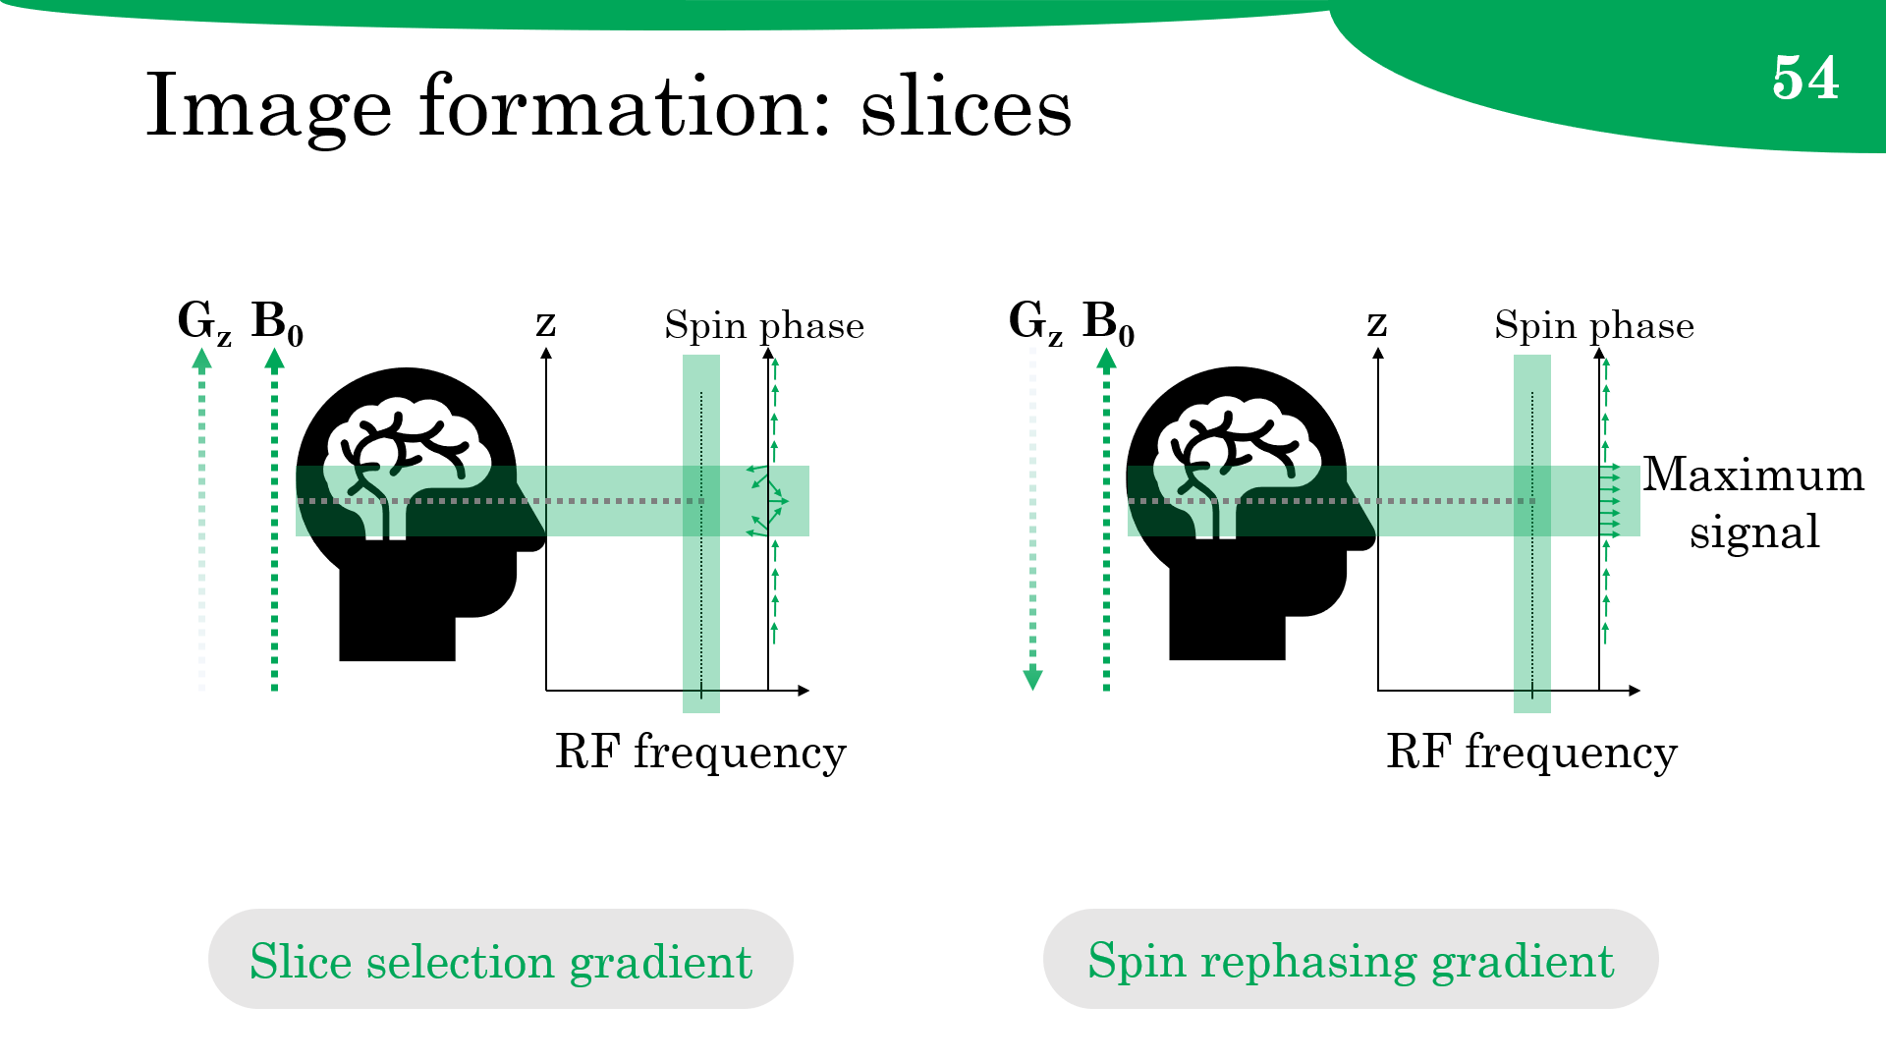
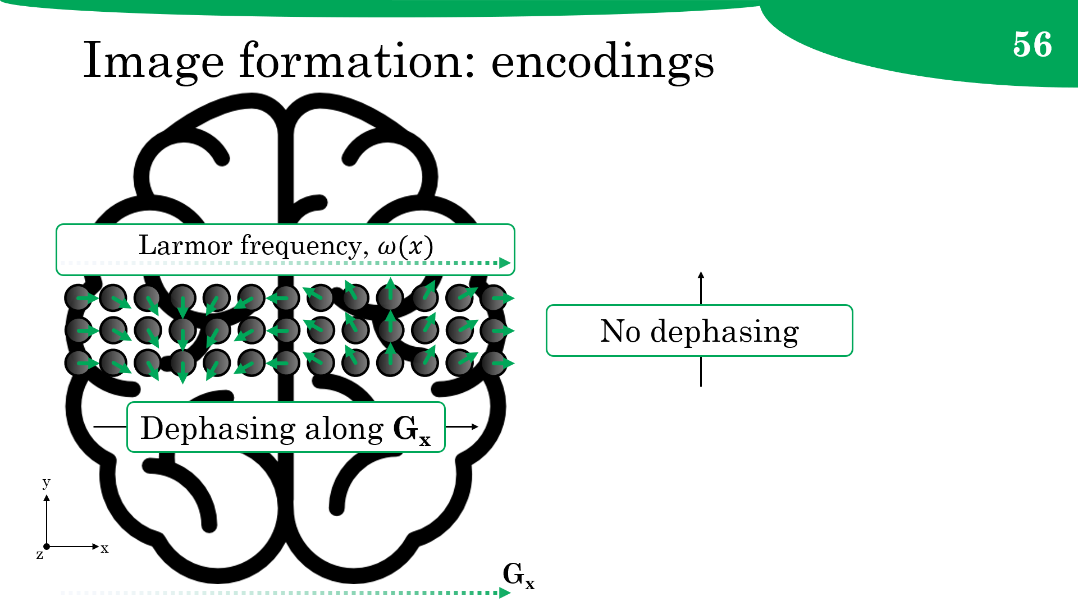
Diffusion: encoding
What diffusion do we measure?
O
O
H
H
O
H
H
H
H
How do we measure diffusion?
Notes:
Note pour présentation physique IRM : La façon la plus simple de faire un encodage "sphérique" c'est en mettant back à back trois gradients linéaires perpendiculaires. C'est évidemment pas optimal pcq ça capture pas toutes les directions, donc on prend plutôt un gradient qui se promène dans le temps et qui encode bien la sphère. Pour le planaire, même chose, on pourrait voir ça comme la combinaison linéaire de deux gradients orthogonaux, mais en réalité on prend plutôt un gradient qui se promène dans le plan pour couvrir la diffusion planaire. Il y a ensuite tout un aspect d'optimisation des waveforms qui mène à des formes de gradients funky.

Slide 66



















Diffusion: encoding
Using dephasing and rephasing diffusion gradients.
After 90° RF pulse
First gradient
Diffusion
Second gradient
B₀
$ω$₀
$ω$₊
$ω$₀
$ω$₀
$ω$₀
$ω$₀
$ω$₊₊
$ω$₀
$ω$₀
$ω$₊
$ω$₀
$ω$₀
$ω$₀
$ω$₀
$ω$₊₊
$ω$₀
$ω$₀
dephasing
$ω$₀
z
+
++
G_{i}
++
+
G_{i}
y
0
0
x
Time
$$δ$$
$$∆$$
$$δ$$
Notes:
Note pour présentation physique IRM : La façon la plus simple de faire un encodage "sphérique" c'est en mettant back à back trois gradients linéaires perpendiculaires. C'est évidemment pas optimal pcq ça capture pas toutes les directions, donc on prend plutôt un gradient qui se promène dans le temps et qui encode bien la sphère. Pour le planaire, même chose, on pourrait voir ça comme la combinaison linéaire de deux gradients orthogonaux, mais en réalité on prend plutôt un gradient qui se promène dans le plan pour couvrir la diffusion planaire. Il y a ensuite tout un aspect d'optimisation des waveforms qui mène à des formes de gradients funky.

Slide 67
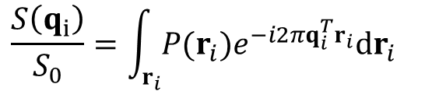

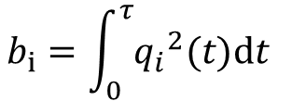
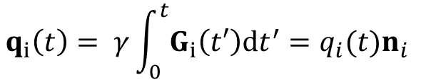


Diffusion: encoding
Stejskal and Tanner sequence (1965)
$$q_{i}\left(t\right)= γ\int_{0}^{t}{G_{i}\left(t′\right)dt^{′}=q_{i}(t)n_{i}}$$
z
G_{i}(t)
Linear
gradient
y
$$b_{i}=\int_{0}^{τ}{{q_{i}}^{2}(t)dt}$$
n_{i}
q_{i}(t)
x
$$δ$$
$$δ$$
t
$$\frac{S\left(q_{i}\right)}{S_{0}}=\int_{r_{i}}{P(r_{i})e^{−i2πq_{i}^{T}r_{i}}dr_{i}}$$
$$∆$$
Analogous to k_{x}, k_{y} and the k-space: q_{i} and the q-space.
Diffusion
signal
Diffusion
propagator
"Wave"
Notes:
Note pour présentation physique IRM : La façon la plus simple de faire un encodage "sphérique" c'est en mettant back à back trois gradients linéaires perpendiculaires. C'est évidemment pas optimal pcq ça capture pas toutes les directions, donc on prend plutôt un gradient qui se promène dans le temps et qui encode bien la sphère. Pour le planaire, même chose, on pourrait voir ça comme la combinaison linéaire de deux gradients orthogonaux, mais en réalité on prend plutôt un gradient qui se promène dans le plan pour couvrir la diffusion planaire. Il y a ensuite tout un aspect d'optimisation des waveforms qui mène à des formes de gradients funky.

Slide 68
Diffusion: sampling
Filling up the q-space
Stejskal-Tanner sequence
Single-shell HARDI
Multi-shell
HARDI
DSI
DTI
Notes:
Note pour présentation physique IRM : La façon la plus simple de faire un encodage "sphérique" c'est en mettant back à back trois gradients linéaires perpendiculaires. C'est évidemment pas optimal pcq ça capture pas toutes les directions, donc on prend plutôt un gradient qui se promène dans le temps et qui encode bien la sphère. Pour le planaire, même chose, on pourrait voir ça comme la combinaison linéaire de deux gradients orthogonaux, mais en réalité on prend plutôt un gradient qui se promène dans le plan pour couvrir la diffusion planaire. Il y a ensuite tout un aspect d'optimisation des waveforms qui mène à des formes de gradients funky.

Slide 69
Principles of MRI: sequences
Slice selection
G_{z}
What we know so far:
90° RF pulse flips the magnetization
90 ° and 180° RF pulses create a spin echo
Pre-pulse prepares the spins for contrast
Gradients G_{z} select a single slice in z-axis
Gradients G_{y} encode the y-axis
Gradients G_{x} encode the x-axis and read
Gradients G_{i} encode the diffusion
Phase encoding
G_{y}
Frequency encoding
G_{x}
Diffusion
encoding
G_{i}
RF pulses
Pre-pulse
90° RF pulse
180° RF pulse
Signal
Spin echo

Slide 70




Diffusion: b-tensor encoding
Time for a little game!
Rules:
Water moves randomly in all directions.
Water moves around objects, not through them.
Camera: only sees water moving towards it.
Goal:
Find out what is inside the aquarium, and where.
Idea:
Taking pictures from various angles.
Regular diffusion MRI
Notes:
Note pour présentation physique IRM : La façon la plus simple de faire un encodage "sphérique" c'est en mettant back à back trois gradients linéaires perpendiculaires. C'est évidemment pas optimal pcq ça capture pas toutes les directions, donc on prend plutôt un gradient qui se promène dans le temps et qui encode bien la sphère. Pour le planaire, même chose, on pourrait voir ça comme la combinaison linéaire de deux gradients orthogonaux, mais en réalité on prend plutôt un gradient qui se promène dans le plan pour couvrir la diffusion planaire. Il y a ensuite tout un aspect d'optimisation des waveforms qui mène à des formes de gradients funky.

Slide 71

Diffusion: b-tensor encoding
Time for a little game!
B-tensor encoding diffusion MRI
Rules:
Water moves randomly in all directions.
Water moves around objects, not through them.
Camera: only sees water moving towards it and
now takes a video, but at the end we only get
the average picture of all the frames.
Goal:
Find out what is inside the aquarium, and where.
Idea:
Taking pictures from various angles.
Notes:
Note pour présentation physique IRM : La façon la plus simple de faire un encodage "sphérique" c'est en mettant back à back trois gradients linéaires perpendiculaires. C'est évidemment pas optimal pcq ça capture pas toutes les directions, donc on prend plutôt un gradient qui se promène dans le temps et qui encode bien la sphère. Pour le planaire, même chose, on pourrait voir ça comme la combinaison linéaire de deux gradients orthogonaux, mais en réalité on prend plutôt un gradient qui se promène dans le plan pour couvrir la diffusion planaire. Il y a ensuite tout un aspect d'optimisation des waveforms qui mène à des formes de gradients funky.

Slide 72



Diffusion: b-tensor encoding
Time for real life!
Rules:
Water moves randomly in all directions.
Water moves around objects, not through them.
Camera: only sees water moving towards it and
now takes a video, but at the end we only get
the average picture of all the frames.
Goal:
Find out what is inside the aquarium, and where.
Idea:
Taking pictures from various angles.
Brownian motion
Restricted diffusion
Diffusion gradient: signal drops when water is moving along its direction.
brain
Measuring signals
Notes:
Note pour présentation physique IRM : La façon la plus simple de faire un encodage "sphérique" c'est en mettant back à back trois gradients linéaires perpendiculaires. C'est évidemment pas optimal pcq ça capture pas toutes les directions, donc on prend plutôt un gradient qui se promène dans le temps et qui encode bien la sphère. Pour le planaire, même chose, on pourrait voir ça comme la combinaison linéaire de deux gradients orthogonaux, mais en réalité on prend plutôt un gradient qui se promène dans le plan pour couvrir la diffusion planaire. Il y a ensuite tout un aspect d'optimisation des waveforms qui mène à des formes de gradients funky.

Slide 73
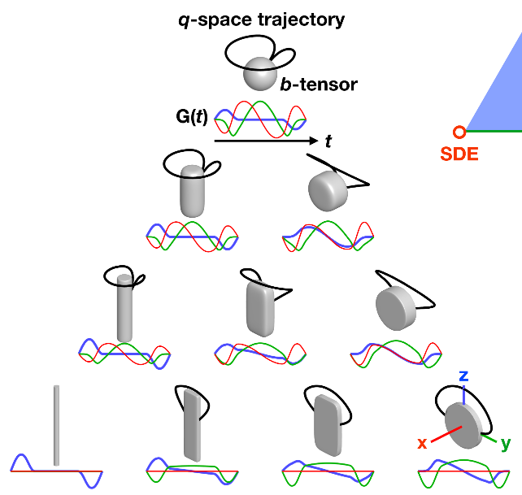


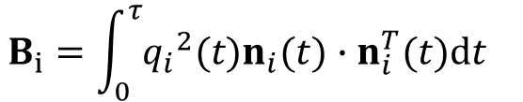
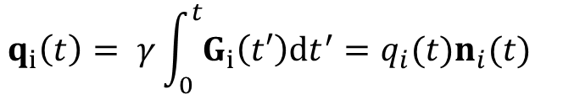

Diffusion: b-tensor encoding
Time for real life!
z
G_{i}(t)
q-space trajectory
Linear gradient
b-tensor
y
n_{i}
G_{i}(t)
q_{i}(t)
x
$$δ$$
$$δ$$
t
$$∆$$
$$q_{i}\left(t\right)= γ\int_{0}^{t}{G_{i}\left(t′\right)dt^{′}=q_{i}(t)n_{i}(t)}$$
z
G_{i}(t)
q_{i}(t)
Non-trivial
gradient
y
$$B_{i}=\int_{0}^{τ}{{q_{i}}^{2}(t)n_{i}(t)∙n_{i}^{T}(t)dt}$$
q_{i}(t)
D. Topgaard, J. Magn. Reson., 2017, 275, 98-113.
x
t
Notes:
Note pour présentation physique IRM : La façon la plus simple de faire un encodage "sphérique" c'est en mettant back à back trois gradients linéaires perpendiculaires. C'est évidemment pas optimal pcq ça capture pas toutes les directions, donc on prend plutôt un gradient qui se promène dans le temps et qui encode bien la sphère. Pour le planaire, même chose, on pourrait voir ça comme la combinaison linéaire de deux gradients orthogonaux, mais en réalité on prend plutôt un gradient qui se promène dans le plan pour couvrir la diffusion planaire. Il y a ensuite tout un aspect d'optimisation des waveforms qui mène à des formes de gradients funky.

Slide 74
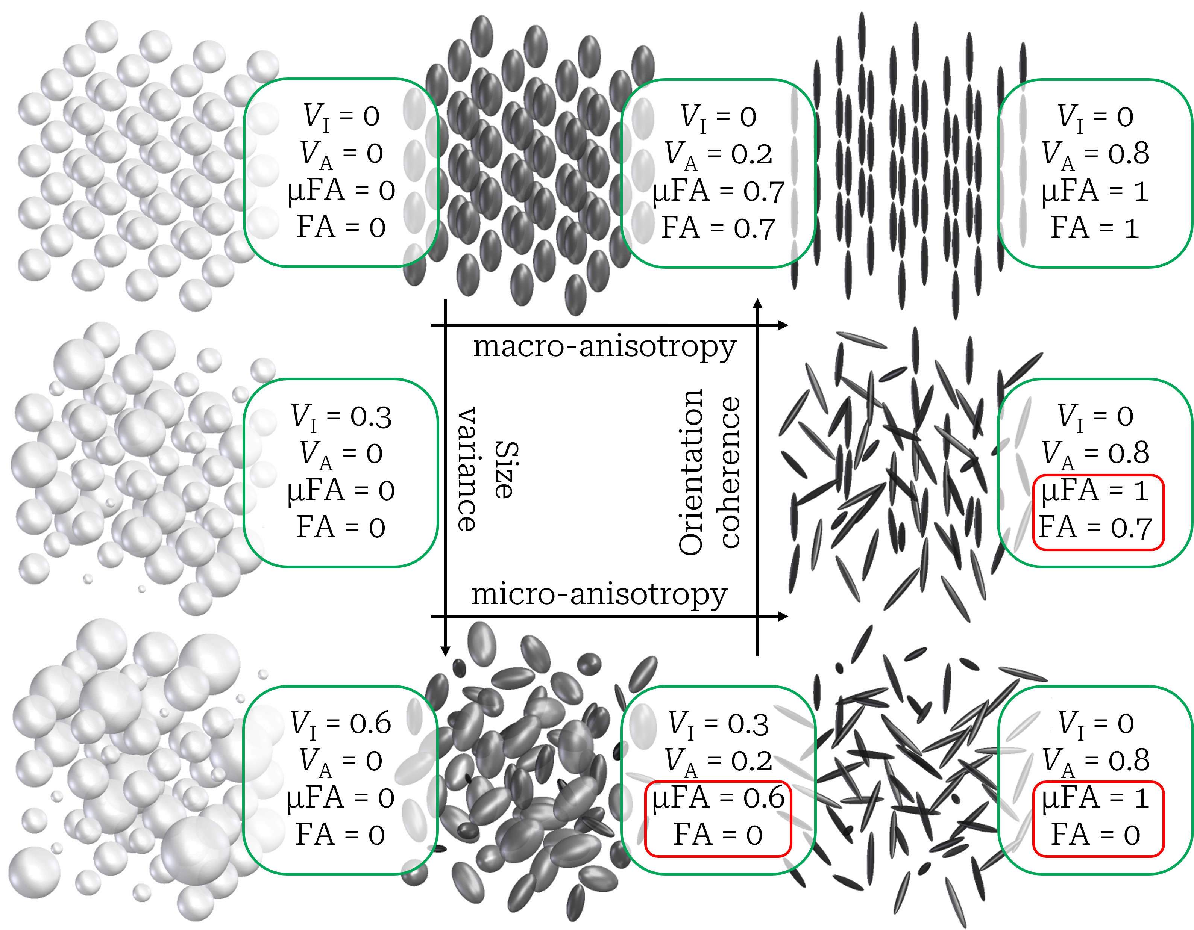
Diffusion: b-tensor encoding
Using at least two encodings allows us to disentangle the isotropic and anisotropic variances.
Notes:
Note pour présentation physique IRM : La façon la plus simple de faire un encodage "sphérique" c'est en mettant back à back trois gradients linéaires perpendiculaires. C'est évidemment pas optimal pcq ça capture pas toutes les directions, donc on prend plutôt un gradient qui se promène dans le temps et qui encode bien la sphère. Pour le planaire, même chose, on pourrait voir ça comme la combinaison linéaire de deux gradients orthogonaux, mais en réalité on prend plutôt un gradient qui se promène dans le plan pour couvrir la diffusion planaire. Il y a ensuite tout un aspect d'optimisation des waveforms qui mène à des formes de gradients funky.

Slide 75
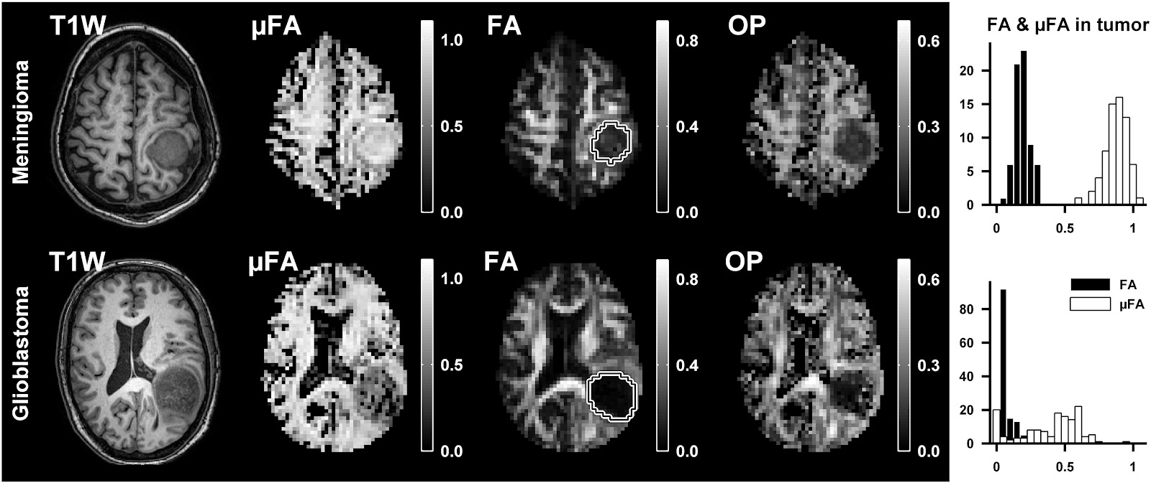
Diffusion: b-tensor encoding
T1
μFA
FA
Meningioma
T1
μFA
FA
Glioblastoma
Notes:
Note pour présentation physique IRM : La façon la plus simple de faire un encodage "sphérique" c'est en mettant back à back trois gradients linéaires perpendiculaires. C'est évidemment pas optimal pcq ça capture pas toutes les directions, donc on prend plutôt un gradient qui se promène dans le temps et qui encode bien la sphère. Pour le planaire, même chose, on pourrait voir ça comme la combinaison linéaire de deux gradients orthogonaux, mais en réalité on prend plutôt un gradient qui se promène dans le plan pour couvrir la diffusion planaire. Il y a ensuite tout un aspect d'optimisation des waveforms qui mène à des formes de gradients funky.

Slide 76
Towards understanding MRI
Physics
  Magnetic field and induction
  Spin and precession
  Magnetization
  Resonance
Principles of magnetic resonance imaging
  Signal
  Relaxation
  Sequences
Image formation
  Slice selection
  Spatial encoding
Diffusion MRI
Magnetization transfer

Slide 77
Myelin imaging
Diffusion tensor imaging
T₁ and T₂ contrasts
Multiexponential T₂ relaxation (MET₂) imaging
Magnetization transfer
Not specific to myelin
Myelin sheath
Heterogeneous : many
T₂ components
Intra/extracellular
water
Axon
MWF =
log(Signal)
Amplitude
Myelin
water
+
Homogeneous : only
one T₂ component
0
0
0
Echo time
T₂ time
Notes:
Note pour présentation physique IRM : La façon la plus simple de faire un encodage "sphérique" c'est en mettant back à back trois gradients linéaires perpendiculaires. C'est évidemment pas optimal pcq ça capture pas toutes les directions, donc on prend plutôt un gradient qui se promène dans le temps et qui encode bien la sphère. Pour le planaire, même chose, on pourrait voir ça comme la combinaison linéaire de deux gradients orthogonaux, mais en réalité on prend plutôt un gradient qui se promène dans le plan pour couvrir la diffusion planaire. Il y a ensuite tout un aspect d'optimisation des waveforms qui mène à des formes de gradients funky.

Slide 78

Magnetization transfer
What is it?
Free water
O
Zeeman
order
RF pulse
O
O
H
H
Free pool
Longitudinal magnetization
Free pool
O
H
H
H
H
O
T_{1, free}
O
H
H
H
H
H
H
Bound water
Magnetization
transfer
O
O
O
H
H
O
H
H
H
H
H
H
Zeeman
order
Dipolar
order
Bound pool
Bound pool
-Δ
$$ω_{0}$$
+Δ
Macromolecule
T_{1, bound}
T_{1D}
Frequency
MT pulse
Absorption lineshapes
Notes:
Note pour présentation physique IRM : La façon la plus simple de faire un encodage "sphérique" c'est en mettant back à back trois gradients linéaires perpendiculaires. C'est évidemment pas optimal pcq ça capture pas toutes les directions, donc on prend plutôt un gradient qui se promène dans le temps et qui encode bien la sphère. Pour le planaire, même chose, on pourrait voir ça comme la combinaison linéaire de deux gradients orthogonaux, mais en réalité on prend plutôt un gradient qui se promène dans le plan pour couvrir la diffusion planaire. Il y a ensuite tout un aspect d'optimisation des waveforms qui mène à des formes de gradients funky.

Slide 79
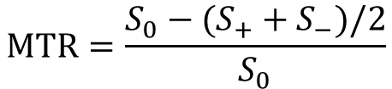

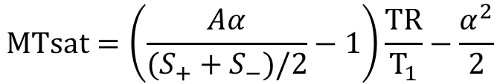
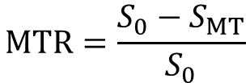
Magnetization transfer
How do we measure it?
Single RF pulse off-resonance.
Bound pool absorbs the energy, both Zeeman and dipolar order are in play.
Magnetization is transfered to the free pool, M_{z} decreases.
Free pool
MT
Zeeman and dipolar order
ihMT
Zeeman order
MT pulse
Bound pool
$$MTR=\frac{S_{0}−S_{MT}}{S_{0}}$$
-Δ
$$ω_{0}$$
+Δ
Frequency
$$MTR=\frac{S_{0}−(S_{+}+S_{−})/2}{S_{0}}$$
Absorption lineshapes
Single RF pulse
Dual RF pulse
Not fully specific to myelin!
$$MTsat=\left(\frac{Aα}{(S_{+}+S_{−})/2}−1\right)\frac{TR}{T_{1}}−\frac{α^{2}}{2}$$

Slide 80
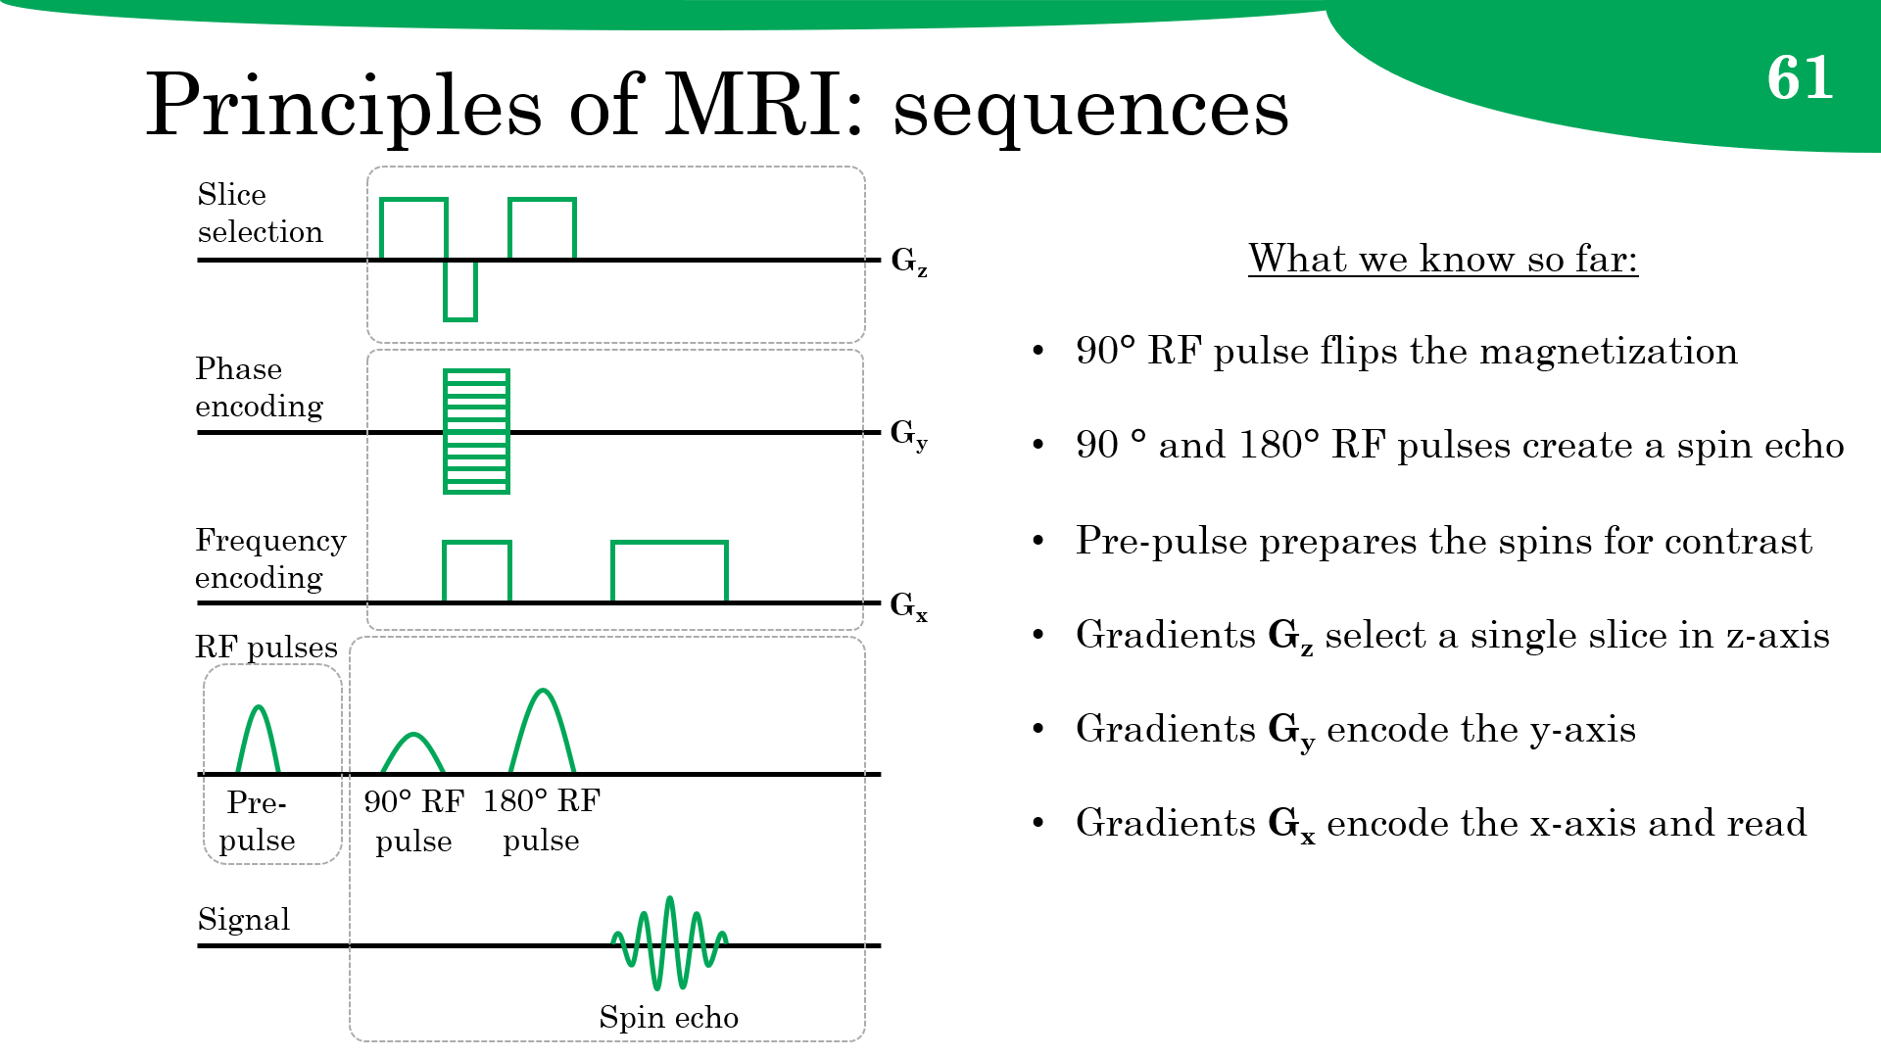
Magnetization transfer

Slide 81

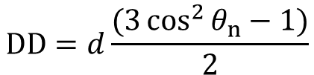











Magnetization transfer
Inhomogeneous MT? (ihMT)
Orientation dependence
$$DD=d\frac{(3\cos^{2}{θ_{n}−1)}}{2}$$
One spin ½
Pair of spins ½
Single RF pulse
Single
$$ω_{0}$$
$$ω_{0}−\frac{3}{2}DD$$
Regular MT
Free pool
Energy
$$ω_{0}$$
$$ω_{0}$$
$$ω_{0}$$
$$ω_{0}+\frac{3}{2}DD$$
Dual
Special MT
$$ω_{0}$$
Pair of spins
Zeeman
Zeeman and dipolar
Dual RF pulse
$$3DD$$
Bound pool
B₀
$θ$_{n}
n
$$ω_{0}$$
Frequency
$$ω_{0}$$
-Δ
$$ω_{0}$$
+Δ
Frequency
Absorption lineshapes

Slide 82


Magnetization transfer
Inhomogeneous MT? (ihMT)
Free pool
MT
Zeeman and dipolar order
ihMT
Zeeman order
MT pulse
Bound pool
-Δ
$$ω_{0}$$
+Δ
Frequency
Absorption lineshapes
Single RF pulse
Dual RF pulse
$$MTR=\frac{S_{0}−(S_{+}+S_{−})/2}{S_{0}}$$
$$ihMTR=\frac{S_{+}+S_{−}−S_{+−}−S_{−+}}{2S_{0}}$$

Slide 83
Magnetization transfer
Inhomogeneous MT? (ihMT)
Isolates the effects of dipolar order:
  More precisely, ihMT is proportional to T_{1D}.
  In particular, typical ihMT is sensitive to long T_{1D}.
Lipid layers of the myelin sheaths satisfy this condition.

Slide 84
Towards understanding MRI
Physics
  Magnetic field and induction
  Spin and precession
  Magnetization
  Resonance
Principles of magnetic resonance imaging
  Signal
  Relaxation
  Sequences
Image formation
  Slice selection
  Spatial encoding
Diffusion MRI
Magnetization transfer

Slide 85
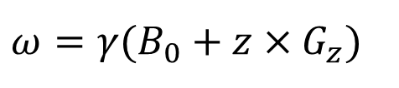
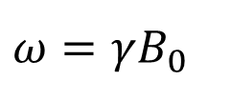
Image formation: slices
G_{z}
B₀
z
Gradient amplitude
One single
Larmor frequency
Multiple
Larmor frequencies
Slice thickness
$$ω=γ(B_{0}+z×G_{z})$$
$$ω=γB_{0}$$
RF frequency
Bandwidth
RF pulse
Bandwidth
Slice thickness
Magnetic field gradient
$$∆ω=γG_{z}×∆z$$
Gradient amplitude

Slide 86
Image formation: slices
G_{z}
B₀
z
Spin phase
G_{z}
B₀
z
Spin phase
Dephasing:
Spiral staircase
Maximum
signal
RF frequency
RF frequency
Slice selection gradient
Spin rephasing gradient

Slide 87


















Image formation: encodings
Spatial encoding with the frequency encoding gradient G_{x}.
$ω$₀
$ω$₀
$ω$₀
$ω$₀
$ω$₊
$ω$₊₊
$ω$₀
$ω$₊
$ω$₊₊
$ω$₀
$ω$₊
$ω$₊₊
$ω$₀
$ω$₀
$ω$₀
$ω$₀
$ω$₊
$ω$₊₊
$ω$₀
$ω$₊
$ω$₊₊
$ω$₀
$ω$₊
$ω$₊₊
$ω$₀
$ω$₀
$ω$₀
$ω$₀
$ω$₊
$ω$₊₊
$ω$₀
$ω$₊
$ω$₊₊
$ω$₀
$ω$₊
y
$ω$₊₊
G_{x}
G_{x}
G_{x}
x
0
+
++
0
+
++
0
+
++
z
Time
Notes:
Tout au long de l’application du gradient G_x, le niveau de déphasage augmente (de façon périodique, en passant parfois par des rephasages). Donc durant G_x on parcourt la ligne k_x.

Slide 88

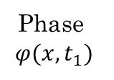
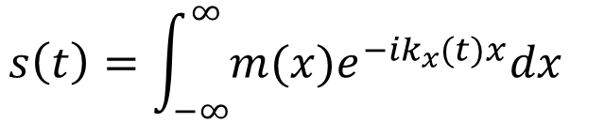
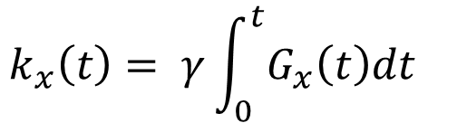
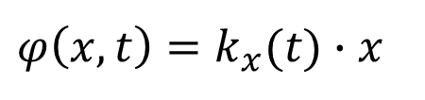


Image formation: encodings
Spatial encoding of the signal from a slice, in the x-axis.
Not the FID!
Phase
$$φ(x,t_{1})$$
k_{x}
360°
Signal
$$φ\left(x,t\right)=k_{x}(t)∙x$$
k_{x}(t₁)
0°
x
$$k_{x}\left(t\right)= γ\int_{0}^{t}{G_{x}\left(t\right)dt}$$
$$t_{1}$$
G_{x}
$φ(x,t_{2})$
360°
720°
1080°
k_{x}(t₂)
$$s\left(t\right)=\int_{−∞}^{∞}{m(x)e^{−ik_{x}(t)x}dx}$$
0°
x
G_{x}
Signal
Image
$$t_{2}$$
Notes:
Tout au long de l’application du gradient G_x, le niveau de déphasage augmente (de façon périodique, en passant parfois par des rephasages). Donc durant G_x on parcourt la ligne k_x.

Slide 89





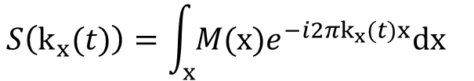

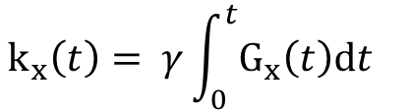





Image formation: encodings
$$t_{0}$$
$φ(x,t)$
k_{x}(t)
$$e^{−i2πk_{x}\left(t\right)x}$$
S(k_{x}(t))
Dephasing
$$t_{0}$$
k_{x}(t₁)
360°
$$φ\left(x,t\right)=\left(γG_{x}x\right)t=k_{x}(t)∙x$$
$$t_{1}$$
0°
x
Spatial frequency
$$t_{1}$$
G_{x}
$$k_{x}\left(t\right)= γ\int_{0}^{t}{G_{x}\left(t\right)dt}$$
$$t_{2}$$
k_{x}(t₂)
360°
720°
0°
x
$$t_{2}$$
G_{x}
$$S\left(k_{x}(t)\right)=\int_{x}{M(x)e^{−i2πk_{x}(t)x}dx}$$
k_{x}(t₃)
360°
720°
1080°
$t_{3}$
0°
x
Signal
Image
"Wave"
$$t_{3}$$
G_{x}
Notes:
Tout au long de l’application du gradient G_x, le niveau de déphasage augmente (de façon périodique, en passant parfois par des rephasages). Donc durant G_x on parcourt la ligne k_x.
Corriger les formules!!!

