Slide 1
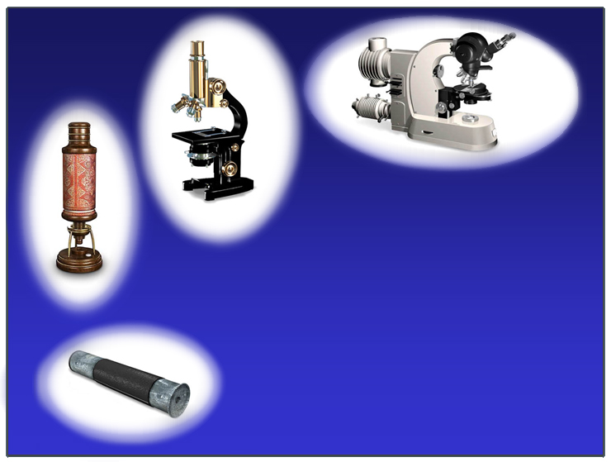
1960
1930
1680
Optical Microscopy
1515

Slide 2

Optical Microscopy
Micro ---- "small"
Skopeîn --- "see"
Human Hair
80 µm
Pollen
40 µm
Lymphocyte
7 µm
Viruses
0.02 -0.3 µm
E. coli
2 µm
Too micro to see
We can see

Slide 3
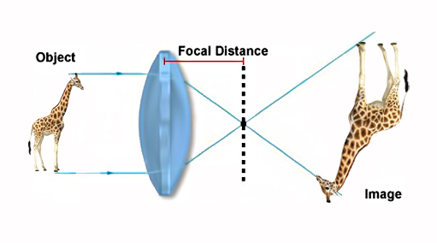
Magnifying
F

Slide 4
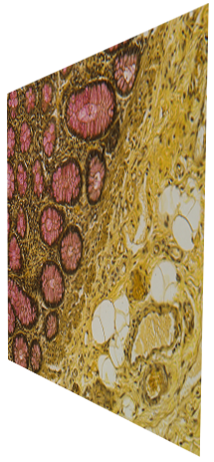

Magnifying

Slide 5
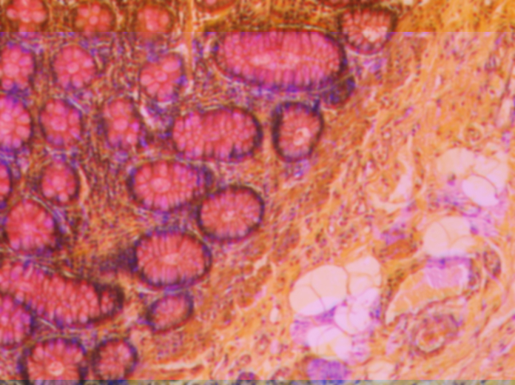
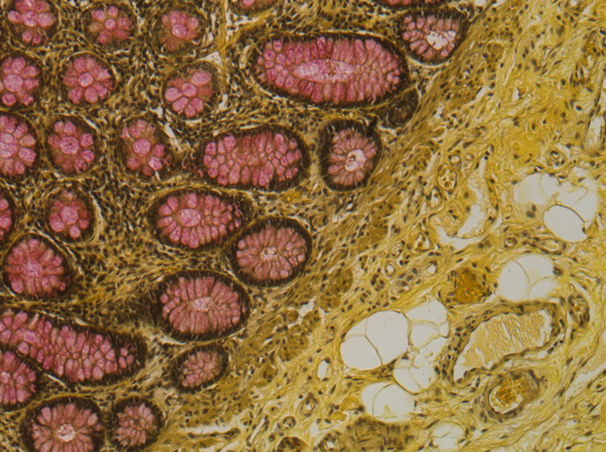
Magnifying

Slide 6
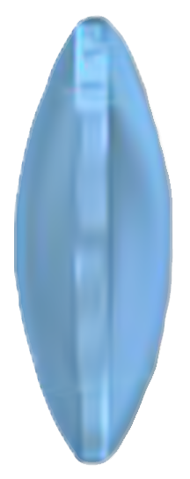
Lens

Slide 7
Chromatic aberrations
  Chromatic aberrations arise from variations in the refractive indices of the wide range of frequencies in visible light

Slide 8
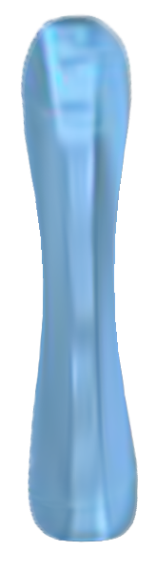
Chromatic aberrations
Concave
Convex

Slide 9
Geometrical or Spherical aberrations
Aberrations are related to the spherical nature of the lens

Slide 10
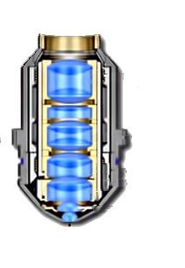
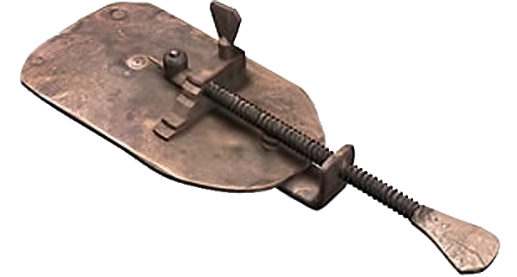
Objectives
Planapochromat
$uper corrected
Lens
Triplet
Group
Lens
Triplet
Group
Lens
Doublet
Groups
Miniscus
Lens
Hemispherical
Front Lens
Leeuwenhoek 1680
Zeiss 2000

Slide 11
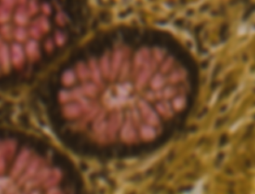

Optical aberrations

Slide 12
Immersion Oil
Refractive Index n =
C
v
c - the speed of light in vacuum
v - the speed of light in the substance
Glass n = 1.52
Air n = 1.000
Immersion Oil
n = 1.515

Slide 13
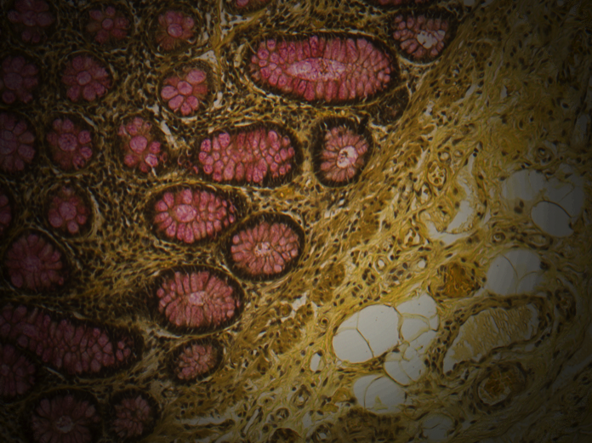
Lighting

Slide 14
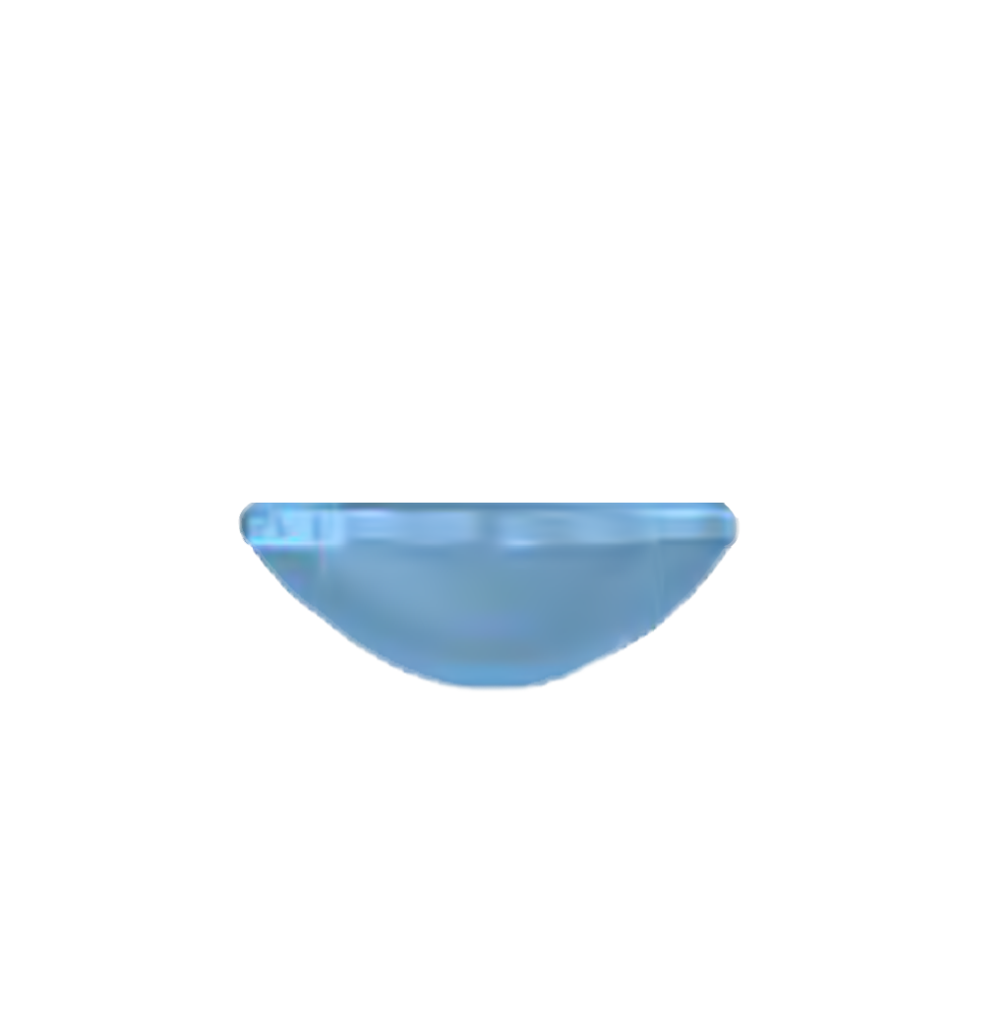
critical to quantitative microscopy
Lighting
CONDENSER
Daylight balancing filter
Neutral Density filter

Slide 15
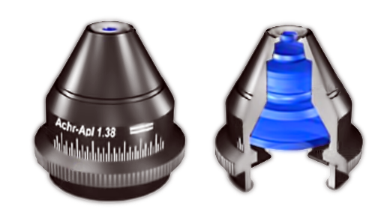
Lighting
Aplanatic-Achromatic
CONDEN$ER
Condencer
Top
Lens
Internal
Lens
Elements
Aperture
Diaphragm

Slide 16
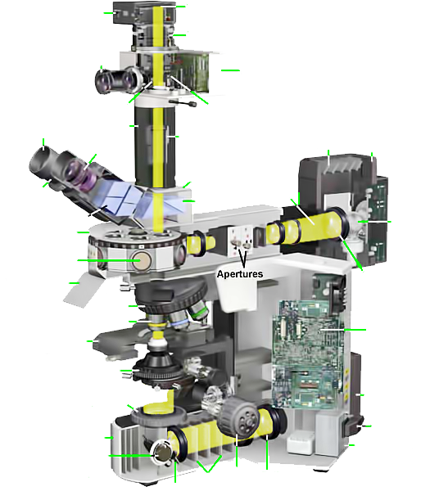
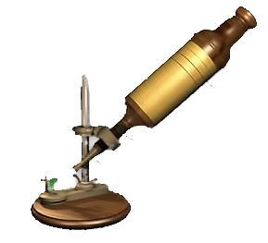
Microscope
Camera
Blck Box
Film Plan
Focusing
Telescope
Electrical Contacts
Automatic
Exposure
Monitor
Shutter
Light
Sensor
Rubber
Eyecup
Extension
Tube
Cooling
Vents
Episcopic
Lamphouse
Projection
Eyepiece
Eyepiece
Lenses
Trinocular
Head
Eyepiece
(Ocular)
Shutter
Prisms
Beamsplitters
Lamp
Vertical
Illuminator
Barrel
Dichroic
Filters
Breathshield
Collector
Lens
Focusing Screw
Nose-
piece
Objective
Objective
Microscope
Control
Circuit
Board
Mecanical
Stage
Condenser
Diascopic
Lamphouse
Field
Diaphragm
Hooke 1670
Line
Cord
Base
Illumination
Intensity
Adjustement
Transformer
Filters
Focus
Knob
Collector
Lens
Mirror
Olympus BX 2000

Slide 17
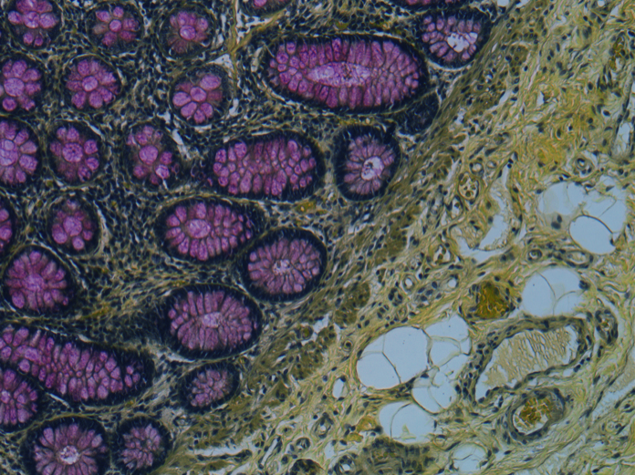
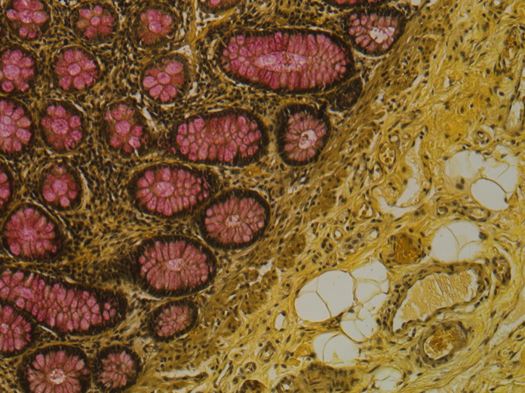
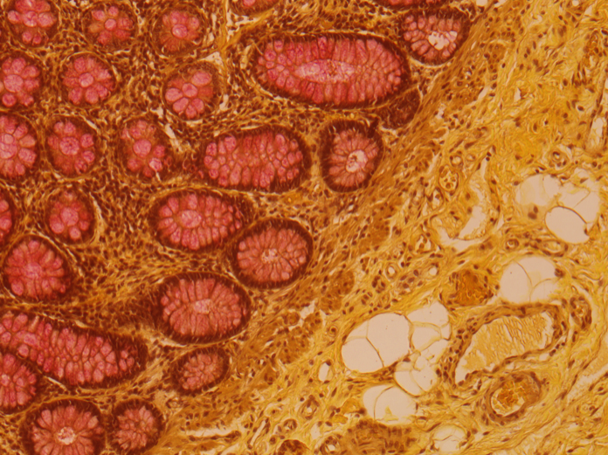
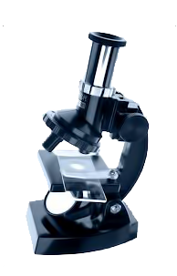
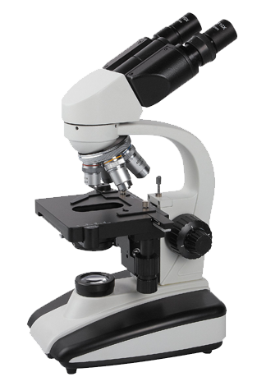
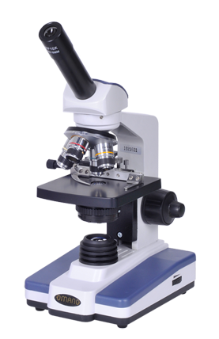
Color Fidelity

Slide 18
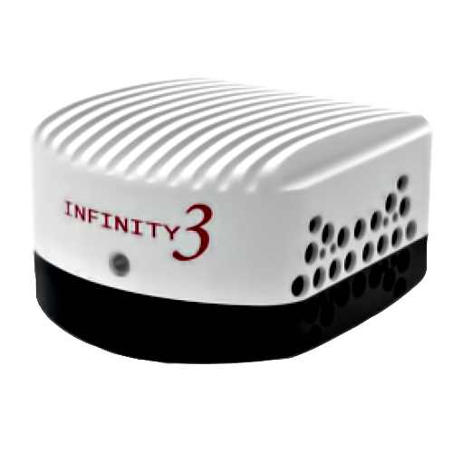
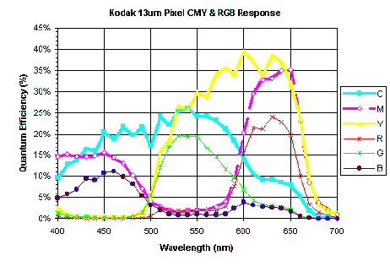
Color Fidelity
CCD Detector

Slide 19
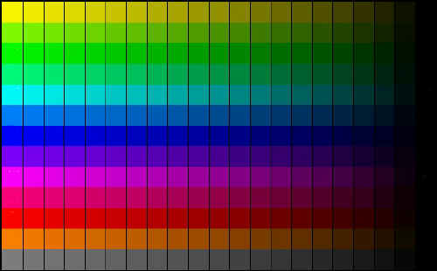

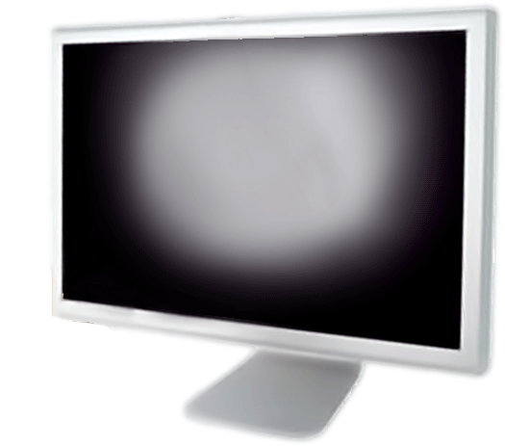
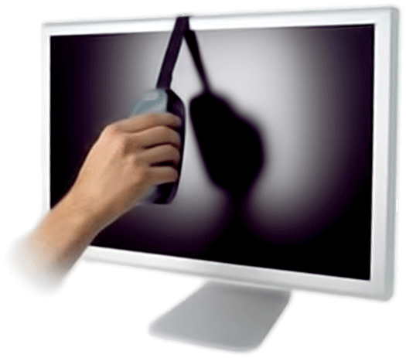
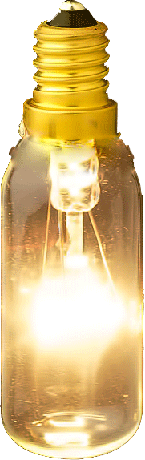
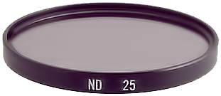
Color Fidelity
Calibration Slide
Monitor Calibration

Slide 20
Optical aberration$$$$$
$$$
$$$$
$$
$
$
$

Slide 21
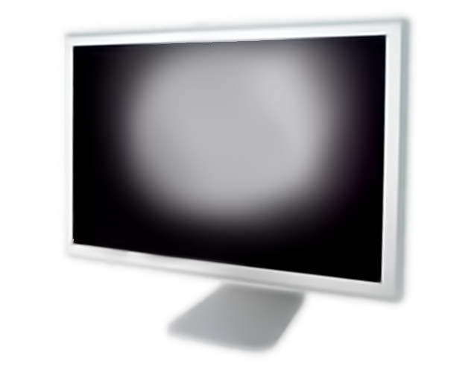
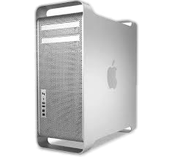
Optical aberration$$$$$
Computational compensation

Slide 22
Computer compensated microscopy
jointly compensates
-- optical aberrations
-- illumination non-uniformities
-- imaging noise within a probabilistic framework.

Slide 23
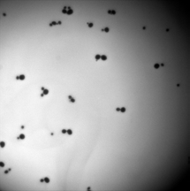
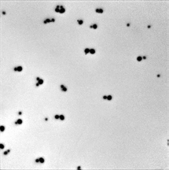

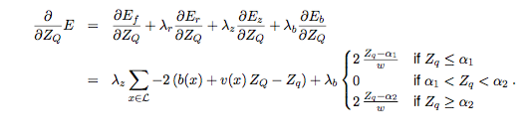
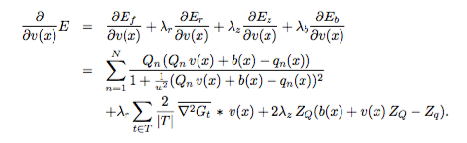
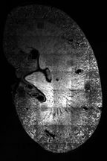
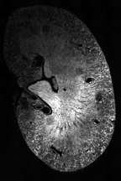
Computer compensated microscopy
Corrected Intensity Distributions using Regularized Energy minimization
CIDRE
As is
CIDREd
K. Smith, Y. Li, F. Piccinini, G. Csucs, C. Balazs, A. Bevilacqua, and P. Horvath, “Cidre: an illumination-correction method for optical microscopy,” Nature methods, vol. 12, no. 5, pp. 404– 406, 2015.

Slide 24
Magnifying
F

Slide 25
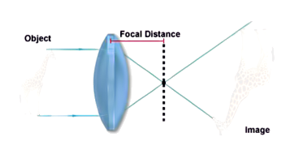
Magnifying
F

Slide 26
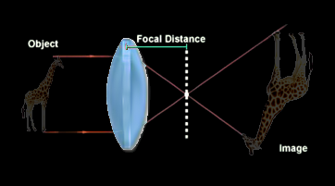
Magnifying
F

Slide 27


Slide 28
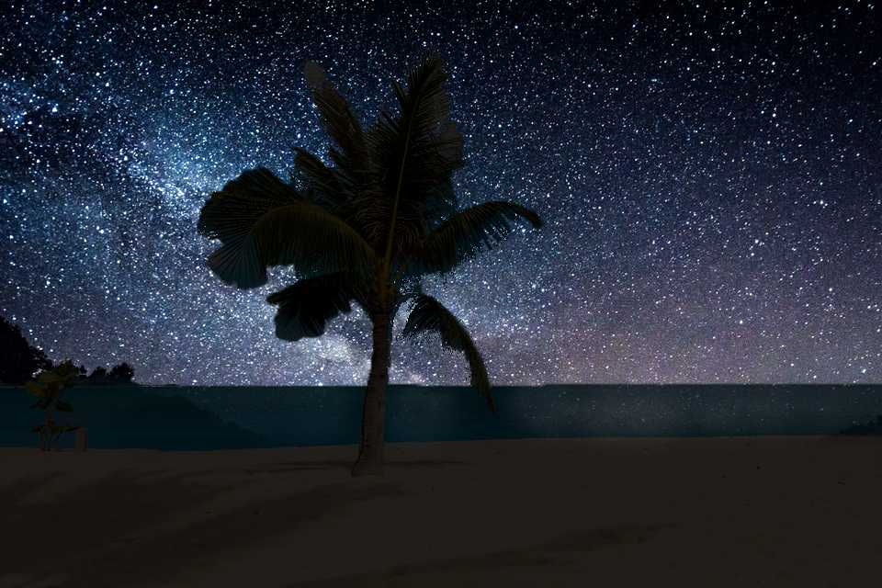

Slide 29
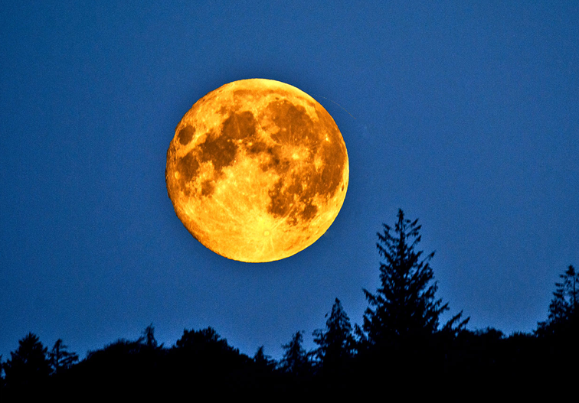


Slide 30

Optical Microscopy
Refraction
Phase shift
Absorption
Fluorescence
Polarization

Slide 31

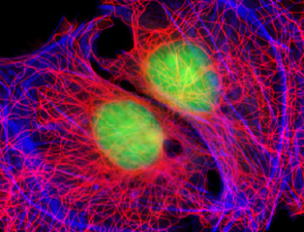
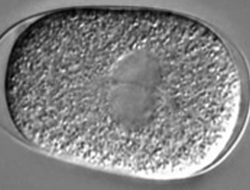
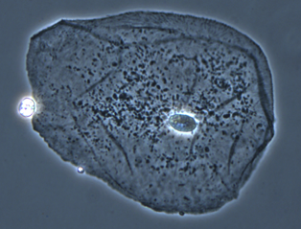
Optical Microscopy
Brightfield
Fluorescent
DIC
Phase contrast
Refraction
Phase shift
Absorption
Fluorescence
Polarization

Slide 32

Fluorescence
400 nm
450 nm
JABLONSKI DIAGRAM

Slide 33

Fluorescence
Incoming
photon
N
M
L
K
Fluorescence

Slide 34
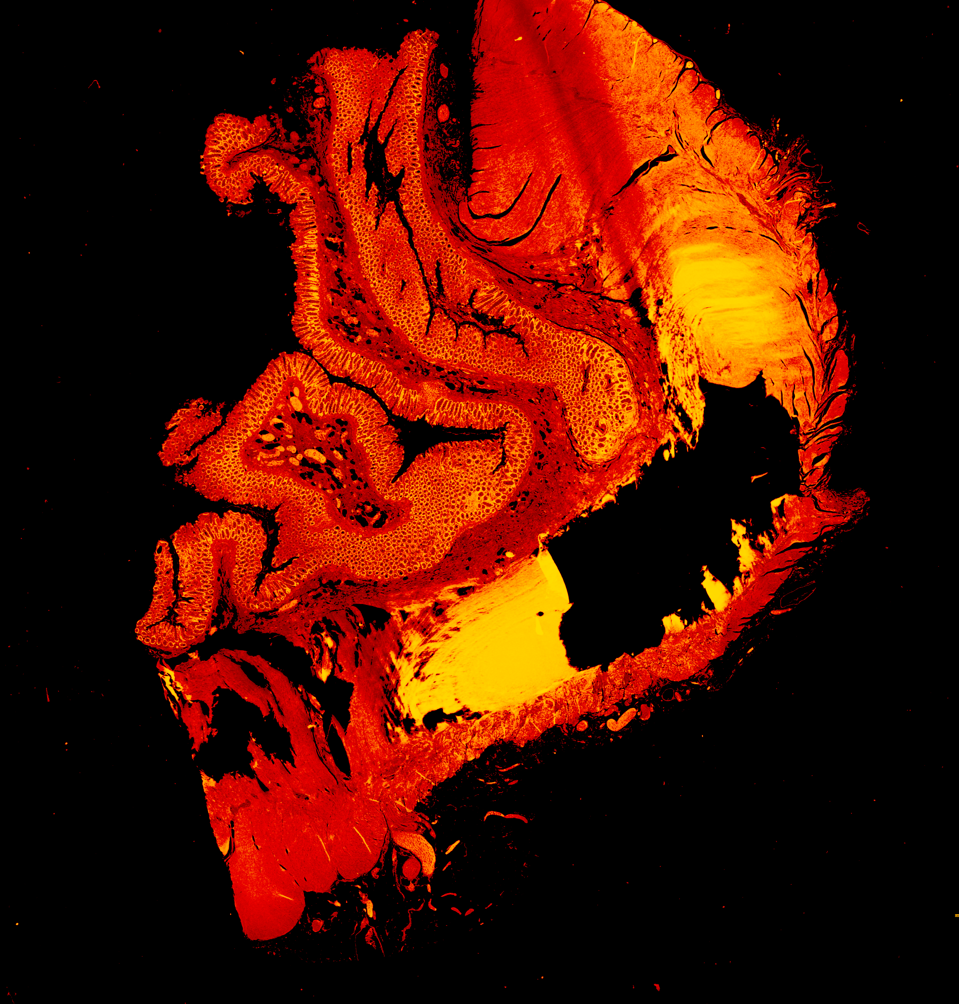
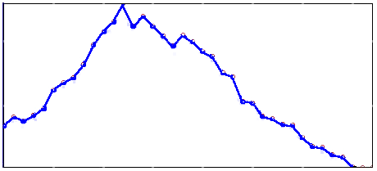
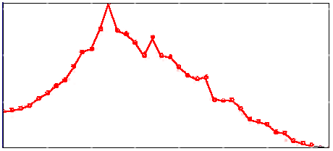
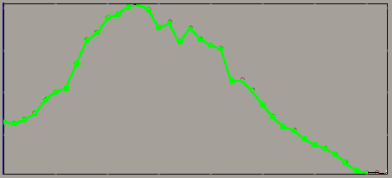
Fluorescence
Mucicarmine stain

Slide 35
Stain -Tissue interaction
Tissue
_
_
Quenching
+
+
Stain
FRET
Ionic
bonds
Hydrogen
bonds
Van der Waals
forces
Covalent
bonds
Fluorescence-lifetime
changes
electron delocalization
Fluorescence spectra modulations
characterize the molecular microenvironment adjacent to ...

Slide 36
Fluorescence
Nearest-Neighbor classification
Local Discriminant Bases
Minimum Noise Fraction Transformation
Complete Linear Spectral Unmixing
Principal Component Transformation
Spectral classifier
Unmixing-based constrained nonnegative matrix factorization
Hierarchical fusion using vector quantization
1BT Based Band Selection
Spectral Weighting Envelopes
Spectral Angle Mapper
Mucicarmine stain

Slide 37
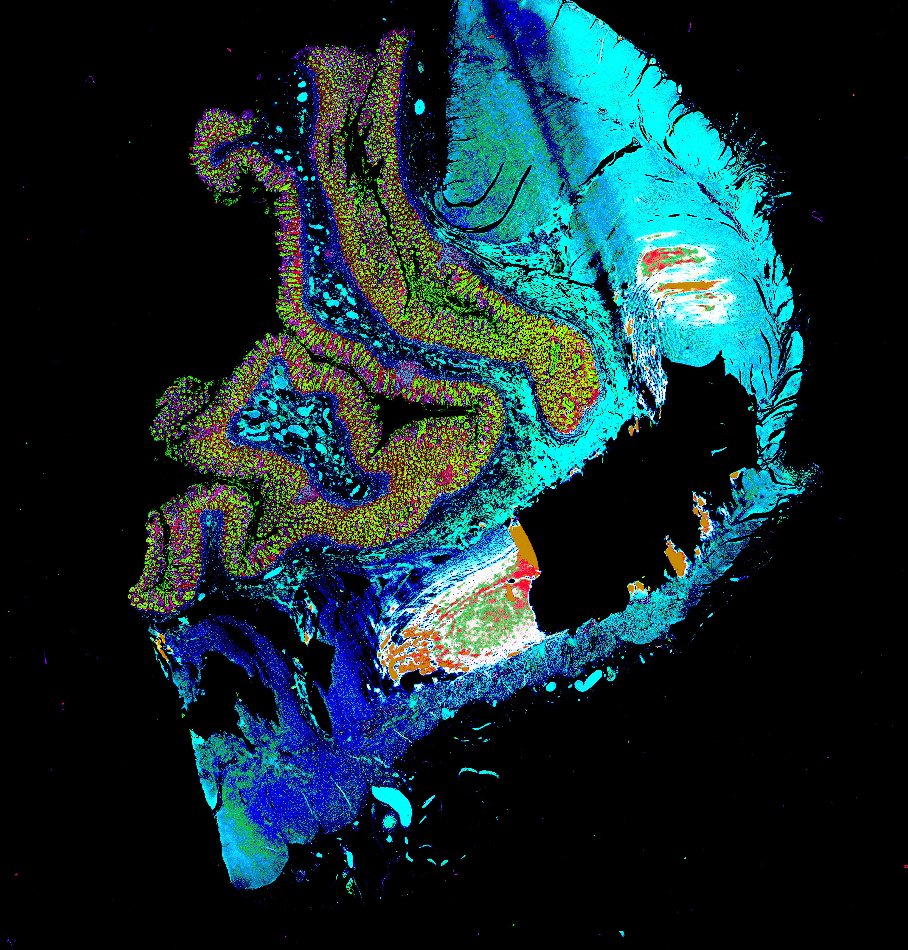
Hyperspectral
Notes:
Journal of Biomedical Optics 19(1), 010901 (January 2014)
Medical hyperspectral imaging: a review

Slide 38
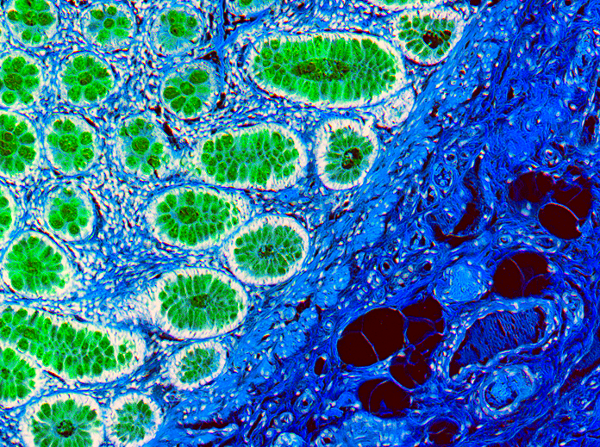
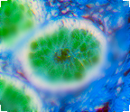

Specimen Thickness

Slide 39

Point Spread Function
Z
Working distance

Slide 40

Point Spread Function
PSF describes the imaging system response to a point input
Z
In microscopy the point spread functions is asymmetric due to lens imperfections

Slide 41





Deconvolution
Optical sectioning
Fast iterative soft-thresholding
Fast iterative soft-thresholding
Richardson–Lucy total variation
thresholded Landweber
DeconvolutionLab2: An open-source software for deconvolution microscopy.
https://www.ncbi.nlm.nih.gov/pubmed/28057586

Slide 42


Deconvolution
Manz at al. * 2000
AutoDeblur from Media Cybernetics
*J Microbiol Methods 2000, 40:125-34.
Tissue sections of Chondrosia reniformis after hybridization with the Bacteria specific probe EUB338

Slide 43


Focus

Slide 44


Slide 45

Confocal microscope
Dr. Marvin Minsky
Confocal microscope: 1957

Slide 46
Confocal microscope
Laser
Scanning
Confocal
Microscope
LASER
Light
Amplification by the
Stimulated
Emission of
Radiation

Slide 47
Confocal microscope
Dichroic
Mirror

Slide 48



Conventional / Confocal

Slide 49

Conventional / Confocal

Slide 50

Light Sheet Microscopy
Single Plane Illumination Microscopy (SPIM)
Medaka juveniles
Japanese rice fish
Philipp Keller, Stelzer Group, EMBL

Slide 51


Biplan Localization Microscopy
Cylindrical
lens
+ 400 nm
0
- 400 nm

Slide 52

Biplan Localization Microscopy
Vutara, Inc..

Slide 53

Magnifying
F

Slide 54
Conventional / Confocal

Slide 55

Confocal

Slide 56
Diffraction
))))))))
)))))))))))))
)))))))))))))
)))))))))))))

Slide 57


Diffraction
Airy disk

Slide 58

Resolution
?
?

Slide 59


Resolution
Abbe diffraction limit
D = 200 nm
Abbe Resolution_{x,y} = λ/2NA
Numerical Aperture
NA = n•sin(θ)
n - refractive index of the imaging medium ( air, oil)
θ - aperture angle (1,4 in the best case)

Slide 60

Resolution
Magic wand

Slide 61
Expansion microscopy
Swellable Polyelectrolyte
Hydrogel
Expansion microscopy: principles and uses in biological research
Asmamaw T. Wassie, Yongxin Zhao & Edward S. Boyden
Nature Methods volume 16, pages 33–41 (2019)

Slide 62

Expansion microscopy
up to ≈ 20 nm ?
Escherichia coli immunolabeled for membrane lipopolysaccharides
Expansion microscopy: principles and uses in biological research
Asmamaw T. Wassie, Yongxin Zhao & Edward S. Boyden
Nature Methods volume 16, pages 33–41 (2019)

Slide 63
Deconvolution
Values from one function are removed from the values of another.
Naive inverse filtering
Tikhonov regularization
Regularized inverse filtering
Landweber
Tikhonov–Miller
Fast iterative soft-thresholding
Richardson–Lucy
Richardson–Lucy with total-variation regularization

Slide 64

Deconvolution
up to 100 nm
Leica-microsystems

Slide 65
Near-field optical microscopy

Slide 66
Near-field optical microscopy
special ($)1.78 refractive index coverslips
special ($ $) 1.78 refractive index oil
special ($ $ $) objective 100x 1.65NA

Slide 67
Near-field optical microscopy

Slide 68
Total internal reflection
up to 20 nm
Evanescent wave
≈100 nm
The critical angle is the angle of incidence above which the total internal reflectance occurs
Θ₂
Θ₁
Evanescent waves quantum tunneling phenomenon
Product of Schrödinger wave equations

Slide 69

Total Internal Reflection Fluorescence Microscopy (TIRF)
up to 20 nm
5 µm
1 µm
McKinney et al.Nature Methods 6, 131 - 133 (2009)

Slide 70
Structured Illumination Microscopy
The Moire effect
+
?
=
-
=
!

Slide 71

Structured Illumination Microscopy

Slide 72

Structured Illumination Microscopy
up to 100 nm

Slide 73
Switch to nonfluorescente state
Fluorescence
Triplet state
Non fluorescent
400 nm

Slide 74
Super-resolution
Optical Fluctuation Imaging (SOFI)
Emission
Desactivation
PA-GFP
Emission
Desactivation

Slide 75
Super-resolution
Optical Fluctuation Imaging (SOFI)
t₁
:
:
:
:
t_{n}
t₁
:
:
:
:
t_{n}
Fast, background-free, 3D super-resolution optical fluctuation imaging (SOFI).
Dertinger T, Colyer R, Iyer G, Weiss S, Enderlein J.
Proc Natl Acad Sci U S A. 2009

Slide 76







Super-resolution
Optical Fluctuation Imaging (SOFI)
up to 50 nm
Richardson–Lucy total variation
Richardson–Lucy total variation
Fast, background-free, 3D super-resolution optical fluctuation imaging (SOFI).
Dertinger T, Colyer R, Iyer G, Weiss S, Enderlein J.
Proc Natl Acad Sci U S A. 2009

Slide 77


Stimulated emission depletion
520 nm
488 nm
+
=
doughnut-shape
Stefan Walter Hell

Slide 78

Stimulated emission depletion
(STED)
up to 50 nm

Slide 79
Fluorescence Localization Microscopy

Slide 80
Fluorescence Photoactivation Localization
Microscopy
Activation
Emission
PA-GFP
PA-GFP
PA-GFP
Localization
(calculation)
Photobleaching

Slide 81
Fluorescence Localization Microscopy

Slide 82

Fluorescence Photoactivation Localization
Microscopy (PALM)
Hess, S.T., T.P. Girirajan, and M.D. Mason. 2006. Ultra-high resolution imaging by fluorescence photoactivation localization microscopy. Biophys J. 91(11):

Slide 83

Fluorescence Photoactivation Localization
Microscopy
up to 20 nm
ZHUANG LAB/HARVARD UNIV.

Slide 84

Super-Resolution Microscopy
Fluorescence nanoscopy in cell biology.
Sahl SJ, Hell SW, Jakobs S.
Nat Rev Mol Cell Biol. 2017 Nov;18(11):685-701.

Slide 85

Super-Resolution Microscopy
Super-resolution microscopy demystified.
Schermelleh L, Ferrand A, Huser T, Eggeling C, Sauer M, Biehlmaier O, Drummen GPC.
Nat Cell Biol. 2019 Jan;21(1):72-84. doi: 10.1038/s41556-018-0251-8. Epub 2019 Jan 2. Review.

Slide 86
Merci !
Merci !

Slide 87
http://www.olympusmicro.com/primer/anatomy/anatomy.html
https://www.microscopyu.com/microscopy-basics
http://zeiss-campus.magnet.fsu.edu/index.html

Slide 88
Fluorescence
Jablonski
diagram
400 nm
450 nm
JABLONSKI DIAGRAM

Slide 89
Fluorescence (true)
Jablonski
diagram
400 nm
450 nm
JABLONSKI DIAGRAM

Slide 90
Fluorescence-Lifetime Imaging (FLIM)
Time (ns)
FL1
F
FL2
FL1
FRET
1-10 nm
Free
Coupled

Slide 91


Fluorescence-Lifetime Imaging (FLIM)
Molecular Interactions
Intracellular pH
Alpy F et al. J Cell Sci. 2013
STARD3 or STARD3NL and VAP form a novel molecular tether between late endosomes and the ER.
Lin HJ et al. Cytometry A. 2003
Fluorescence lifetime-resolved pH imaging of living cells.

Slide 92

Confocal Olympus FV1000
453 nm
488 nm
515 nm
Hooke 1670
Hexadimensional
(space- time)
Microscopy
543 nm
633 nm
Fluorescence
- Lifetime
Z Compensate System
λ
Z
Y
X
Time

Slide 93


Confocal PSF
WF
CF

Slide 94
Fluorescence
Jablonski
diagram
400 nm
450 nm
JABLONSKI DIAGRAM

Slide 95

Wavelength and Light Properties
(λ)
575 nm
High
Energy
Low
Energy
E = h c / λ
0,5* *2

Slide 96
Multiphoton exitation
Jablonski
diagram
400 nm
800 nm
1200 nm
1200 nm
800 nm
1200 nm
450 nm
JABLONSKI DIAGRAM
Dr. Maria Göppert-Mayer : theory of two-photon quantum transitions
(two-photon absorption and emission) 1931,

Slide 97
Temporal photon concentration
Wavelength Tunability
LASER
500 nm
Pulsed LASER
1000 nm
1200 nm
800 nm
500
nm
800
1200
nm

Slide 98
Spatial photon concentration
Prof. Watt W. Webb et al.
Two-photon laser scanning
fluorescence microscopy: 1990

Slide 99
Confocal / Multiphoton

Slide 100



Photoconversion
Excitation area
Luo at al. Cell Structure and Function 2006, 31: 63
Comparison of photoactivation of PA-GFP in vivo with single-photon (405 nm) and multiphoton (790 nm) laser light.

Slide 101

In VIVO Imaging
Thorsten at al. Nature 2004; 427: 159
T-cell priming by dendritic cells in lymph nodes occurs in three distinct phases

Slide 102
Conventional / Confocal / Biphoton

Slide 103

Science Vol. 385, No. 6713 ; 6 Sep 2024

Slide 104



Multiphoton polarization microscopy
Anisotropic optical properties of molecules
“Biphotonic”
Laser
Linear dichroism
polarizator

Slide 105


Biphoton polarization microscopy
G-proteins orientation
Base line
+ Norepinephrine
Cell expressing GAP43-CFP-Gαi2 and α2a-adrenergic receptor
Lazar J et al. Nat Methods. 2013
Two-photon polarization microscopy reveals protein structure and function

Slide 106



Förster Resonance Energy Transfer (FRET)
Molecular Basis
YFP
YFP
CFP
CFP
FRET
1-10 nm

Slide 107
Confocal Olympus FV1000
453 nm
488 nm
515 nm
Hooke 1670
Hexadimensional
(space- time)
Microscopy
543 nm
633 nm
Fluorescence
- Lifetime
Z Compensate System
λ
Z
Y
X
Time

Slide 108
Super-resolution
Bleaching Assisted Localization Microscopy(BALM)
t₁
:
:
:
:
t_{n}
t₁
:
:
:
:
t_{n}
Fast, Bleaching/blinking assisted localization microscopy for
superresolution imaging using standard fluorescent molecules.
Burnette DT, Sengupta P, Dai Y, Lippincott-Schwartz J, Kachar B.
Proc Natl Acad Sci U S A. 2011 Dec 27;108(52):21081-6

Slide 109





Super-resolution
Bleaching Assisted Localization Microscopy(BALM)
Up to 50 nm of lateral resolution and ? nm of axial resolution
Fast, Bleaching/blinking assisted localization microscopy for
superresolution imaging using standard fluorescent molecules.
Burnette DT, Sengupta P, Dai Y, Lippincott-Schwartz J, Kachar B.
Proc Natl Acad Sci U S A. 2011 Dec 27;108(52):21081-6

Slide 110

Stimulated emission depletion 3X
X Y
+
=
X Y Z

Slide 111

Stimulated emission depletion
(STED 3X)
Up to 50 nm of lateral and axial resolution

Slide 112
Switch to nonfluorescente state
Ground state depletion
Fluorescence
400 nm
Triplet state
550 nm
Non fluorescent
Thiols
(R-SH)
600 nm
Ground state
JABLONSKI DIAGRAM

Slide 113
Ground State Depletion Microscopy
direct Stochastic Optical Reconstruction Microscopy
Total Deactivation
(Ground State Depletion)
Stochastic Activation
FITC
FITC
FITC
Emission
Localization
(calculation)

Slide 114

Ground State Depletion Microscopy

Slide 115
Optical Microscopy
Brightfield
Fluorescent
DIC
Phase contrast
Refraction
Phase shift
Absorption
Fluorescence
Polarization

Slide 116

Light-Tissue interaction
Fixation (or not)
Stain
RAMAN
Fluorescence
Wave shape
Changes
(𝜆 ; polarization)
AutoFluorescence
Absorbance
RAMAN: https://en.wikipedia.org/wiki/Raman_scattering

